Slide 1

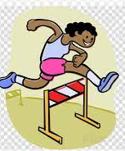

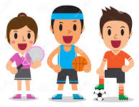






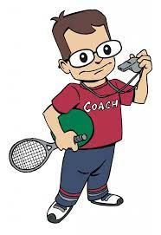




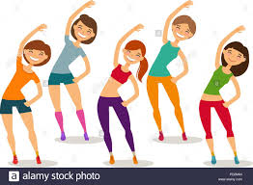









ROAD MAP OF
THE PE CURRICULUM
Yr 10 Btec Tech Award in Sport, Activity and Fitness
Yr 10 Sports Science
Sport Options for KS4
Yr 9 Sports Day
PE INTENT
’to develop a lifelong involvement of physical activity, sport and exercise’
‘have good physical health, emotional and social wellbeing’
‘lead healthy and active lifestyles’
Lead healthy and active lifestyles
Taster sessions for KS4 courses
Sports Competitions
Physical fitness
Swimming - Life Saving Skills
9
Alternative Games
Core PE
Developing skills to become Young Sports Leaders
Take part
In my
2nd Sports Day
Rules of Tennis
Striking and fielding games
Focus on skills within athletics disciplines
Improving swimming technique
Take part in an Athletics competition
Build on leadership skills
Developing Gymnastics Skills
Exploring different types of dance
Hand eye co-ordination
in racket sports
Sports Competitions
Improve well being take part in fitness activities
8
Making space in team games
Participate in more new sports
Look at developing team games
How to hold and throw effectively in athletics
Gymnastics
Hand eye co-ordination
Take part
in my 1st
Sports Day
Developing water confidence
Basic rules in individual sports
Ball control in game situations
7
Develop team skills
Represent
a school
team
Get my PE kit
The importance of warming up
The importance of staying active
Attend my 1st PE lesson & meet the staff
Join an extra-curricular club
Participate in a range of new activities

