Slide 1





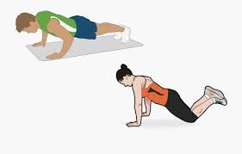
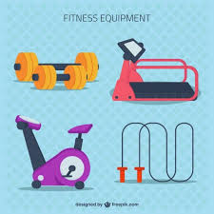
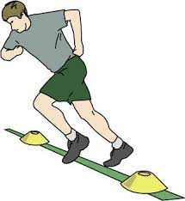

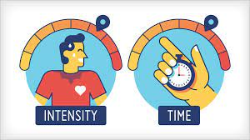
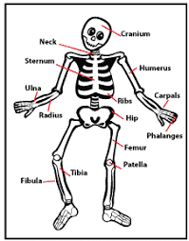
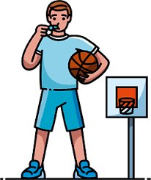
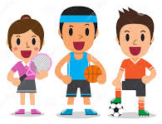
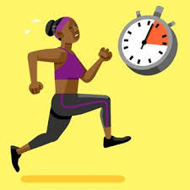



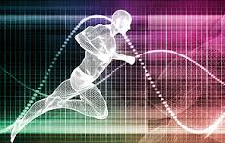
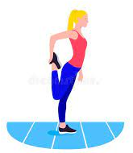
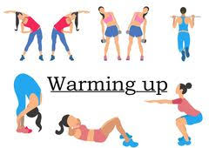







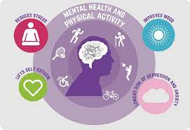
ROAD MAP OF
Btec Tech Award in Sport, Activity and Fitness
Fitness programme design
PE INTENT
’to develop a lifelong involvement of physical activity, sport and exercise’
‘have good physical health, emotional and social wellbeing’
‘lead healthy and active lifestyles’
Component 3
External Assessment
Fitness Testing
Requirements of administering fitness tests
The effects of exercise on the body
Exercise intensity
Fitness training methods
The importance of the components of fitness
Principles of training
Component 2 Internal assessment
Learners will lead their planned drills session.
Component 3: Developing Fitness to Improve Other
Participants Performance in Sport and Physical Activity
11
Plan a sports skills session
Practical performance of skills in a selected sport
Understand what drills improve sports performance
Components of physical and skill related fitness.
Component 2: Taking Part and Improving Other
Participants Sporting Performance
The role of the officials in sport
Rules and regulations in sports
Component 1 Internal assessment
Technology used in Sport to improve performance
Leading a warm up
The different types of sports clothes and equipment used in sport
Planning a warm up
Component 1: Preparing Participants to Take Part in Sport and Physical Activity
How to overcome barriers
10
Barriers to participation in sport and physical activity
Types and providers of sport and physical activities
Types and needs of sport and physical activity participants

