Slide 1

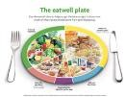



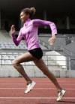

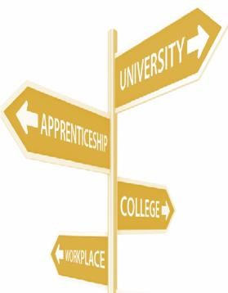






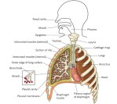

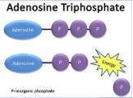






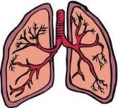


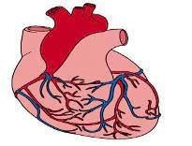
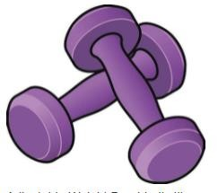







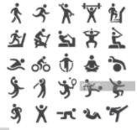

KS4 BTEC Tech award & KS5 BTEC Sport Curriculum
Map
Learning Aim D
Learning Aim C
Unit 2 Students will revise and complete the
Unit 2 external examination/resit opportunity.
Students will understand programme-related nutritional needs and undertake a recruitment activity to demonstrate the processes that can lead to a successful job offer.
Students will examine training methods for different components of fitness and reflect on the recruitment and selection process.
Final Exam Preparation
Units 2 & 3
Learning Aim B
Learning Aim A
Students will understand the screening processes for training programming & explore own skills using a skills audit to inform a career
Unit 2 Students will revise and complete the
Unit 2 external examination/resit opportunity for unit 1.
Students will continue their journey with an introduction to units 2 & 3.
Students will examine lifestyle factors and their effect on health and well-being & understand the career and job opportunities in the sports industry.
Unit 3
Assignment 1
development action plan. _{Internal Assessment}
Careers in Sport
YEAR
13
Units 1 & 2
Unit 1 Students will revise and complete the
Unit 1 external examination.
Units 2 & 3
Units 2 & 3
Unit 3
Unit 1
Learning Aim E
Learning Aim D
Learning Aim C
Unit 7
Assignment 1 Internal Assessment Increasing Participation in Olympic Individual and Team Sports.
Students will learn the effects of exercise and sports performance on the energy systems.
Students will learn the effects of exercise on the cardiovascular system & reflect on own practical performance using selected assessment methods.
Students will learn the effects of exercise on the respiratory system & develop skills, techniques and tactics for sporting activity.
Unit 7
Assignment 2 Internal Assessment Assessing Performance in an individual and team sport.
Unit 7
Units 1 & 7
Component D
Students will investigate fitness programming to improve fitness and sports performance, design fitness programmes, and explore motivational techniques for fitness programming.
Students begin their L3 journey with an introduction to the course.
Learning Aim A
Students will learn the effects of exercise on the skeletal system & examine National Governing Body rules & regulations for selected sports.
Unit 7
YEAR
Component 3 C4-6
12
Component 3 B1-4
Students will Investigate fitness testing to determine fitness levels, fitness test methods for components of physical fitness and skill- related fitness, and interpretation of fitness test results.
Units 1 & 7
Students will explore additional requirement s for each of the fitness training methods, provision for taking part in fitness training methods, and the effects of long-term fitness training on the body systems.
Component 3: Developing fitness to improve other participants performance in sport and physical activity.
YEAR
Component 3
11
Component 3 C1-3
Students will investigate different training methods, fitness training methods for physical components of fitness and skill-related components of fitness.
Component 3 A1-3
Students will explore the importance of fitness for sports performance, fitness training principles, exercise intensity, and how it can be determined.
Learning outcome C
Students will demonstrate ways to improve participants’ sporting techniques.
Students will revise and complete the Unit 1 online external examination.
Learning outcome C Students will be
able to prepare participants to take part in sport and physical activity.
Online Examination
Component 2
Taking part and improving other participant’s sporting performance
Students will continue their BTEC journey by commencing the internal, externally moderated component 2.
Learning outcome A
Learning outcome B
Students will be able to participate in sport and understand the roles and responsibilities of officials.
Students will understand how different components of fitness are used in different physical activities.
Learning outcome B
Students will examine the equipment and technology required for participants to use when taking part in physical activity.
Component 1
YEAR
10
Learning outcome A Students will explore types and provision of sport and physical activity for different types of participant.
Preparing participants to take part in sport and physical activity
Pupils begin their journey by commencing this internal, externally moderated assessment.

