Slide 1

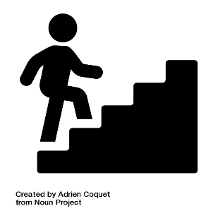
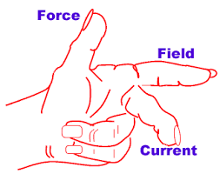

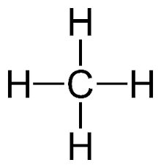

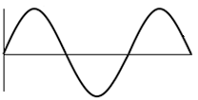



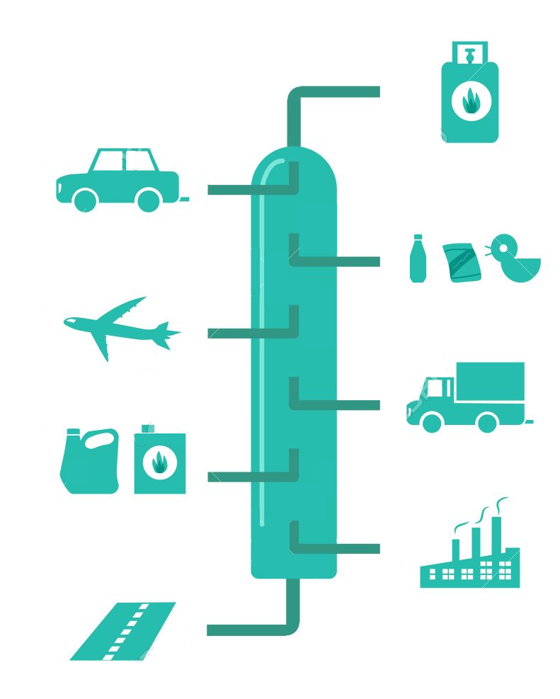
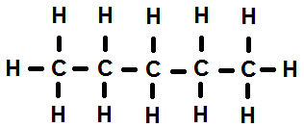

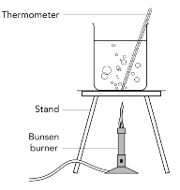
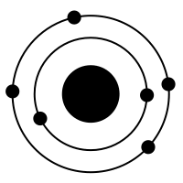

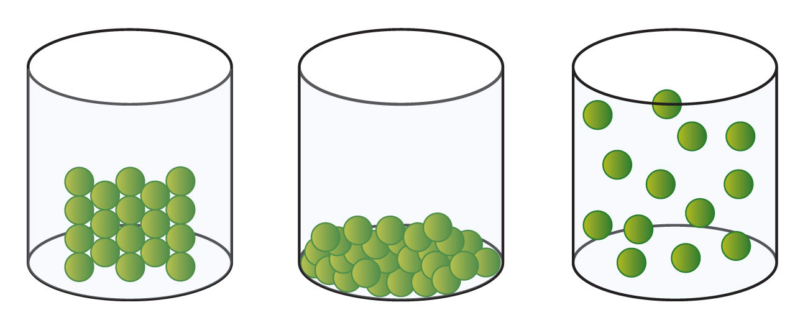
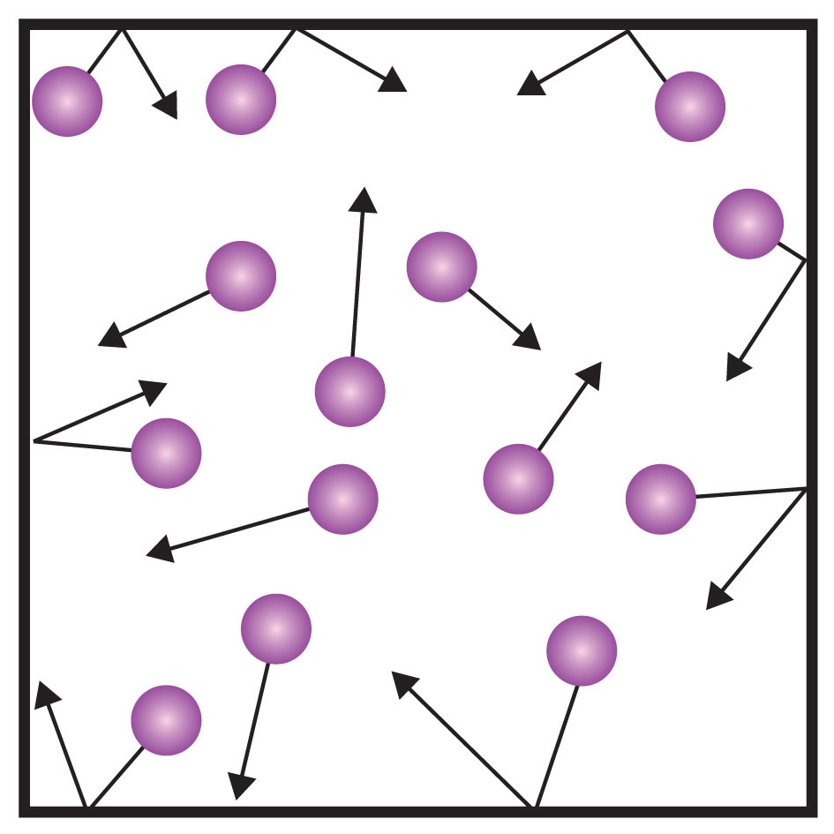

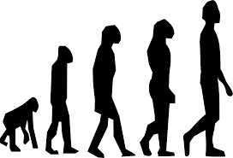
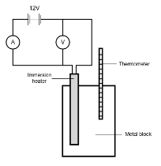







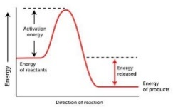

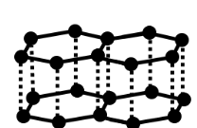
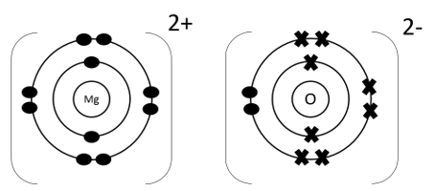
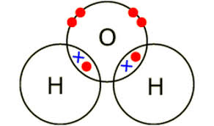




Combined Science KS4 Learning Journey
A level Sciences – Biology, Chemistry and Physics
(Need grade 6 and above and grade 6 in Maths)
End of year exams!!
Permanent and induced magnets
BTEC Human Biology
(Need Grade 5 in Science)
P7 Magnetism and electromagnetism
Other post 16 options – Apprenticeships, other A level subjects, other BTEC subjects, other training, College?
The motor effect
Transverse and longitudinal waves
Electromagnetic waves
Greenhouse gases
C10 Using resources
Life cycle assessments and recycling
Interactions of forces
Work done and energy transfer
C9 Chemistry of the atmosphere
P6 Waves
Chromatography
Atmospheric pollutants
Potable water
P5 Forces
Scalars and vectors
Forces and motion
Momentum
Evolution of the Earth’s atmosphere
C8 Chemical analysis
Purity and formulations
C7 Organic Chemistry
Rate of reaction
Biodiversity and human interaction
Adaptations
Classification
Fractional distillation
Understanding genetics and evolution
Carbon compounds
Reversible reactions and dynamic equilibrium
C6 The Rate and Extent of Chemical Change
Organisation of an ecosystem
B7 Ecology
Variation and evolution
Internal energy and energy transfers
P4 Atomic Structure
Atoms and isotopes
Hormonal control in humans
Reproduction
B5 Homeostasis and response
YEAR
Changes of state
11
B6 Inheritance, variation and evolution
pressure
P3 Particle model of matter
Atoms and nuclear radiation
Homeostasis
The nervous system
Energy transfers
Exothermic and endothermic reactions
Series and parallel circuits
National and global energy resources
Specific heat capacity
P1 Energy
C5 Energy Changes
Domestic uses and safety
Electrolysis
Current, potential difference and resistance
P2 Electricity
Conservation and dissipation of energy
Energy changes in a system and stores
Reaction profiles and bond energies
Reactions of acids
C1 Atomic Structure and the Periodic Table
Relative atomic mass
Chemical bonds, ionic, covalent and metallic
Structure and bonding of carbon
Conservation of mass
Reactivity of metals
Periodic table
Photosynthesis
C4 Chemical Changes
B4 Bioenergetics
Model of the atom
C2 Bonding, Structure and the properties of matter
How bonding and structure are related to properties
C3 Quantitative Chemistry
O=C=O
Moles
Respiration
Relative formula mass
Discovery and development of drugs
Communicable diseases
Digestive system, enzymes and food tests
Principles of organisation
Exchange surfaces and SA:V
Cell division and stem cells
B1 Cell biology
YEAR
Human defence systems and vaccination
10
B3 Infection and response
Health and disease
The circulatory system
B2 Organisation
Transport in cells
Diffusion, osmosis and active transport
Cell structure, specialisation and microscopy

