Slide 1





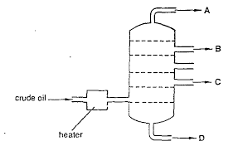
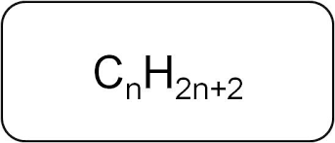
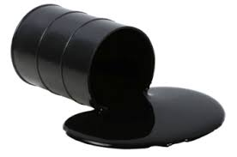

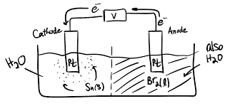
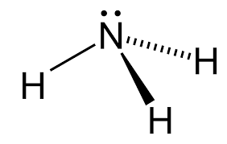


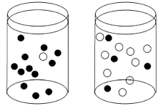
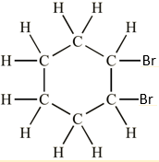
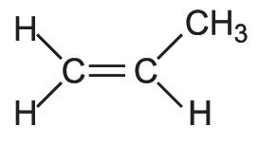
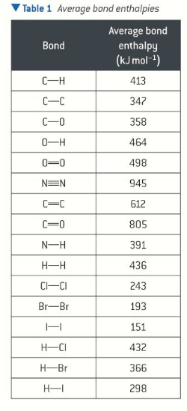
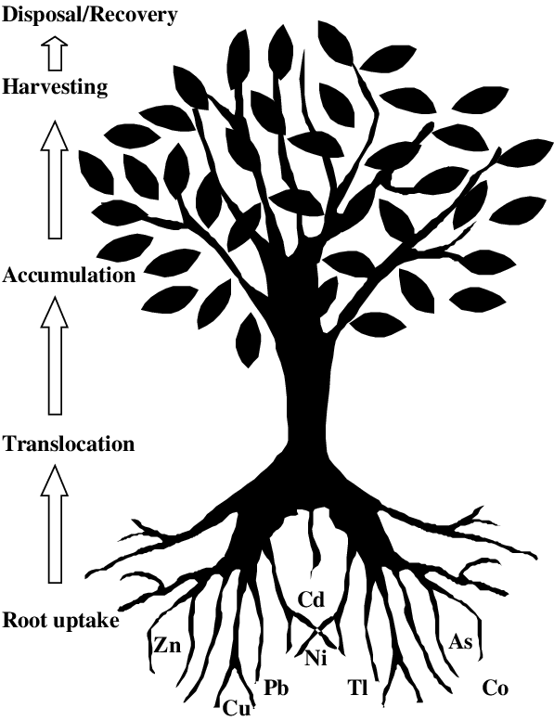
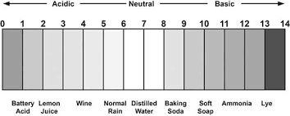
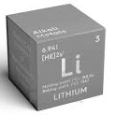

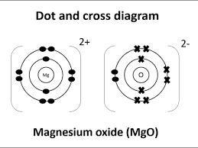

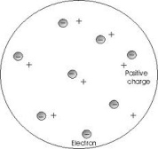
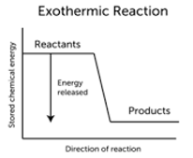
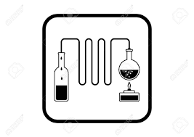
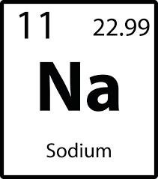
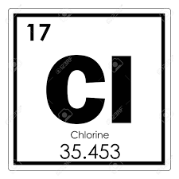
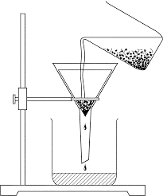
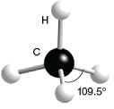
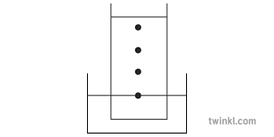
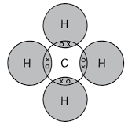
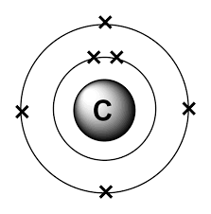


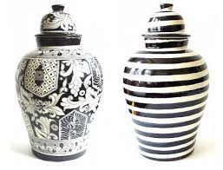

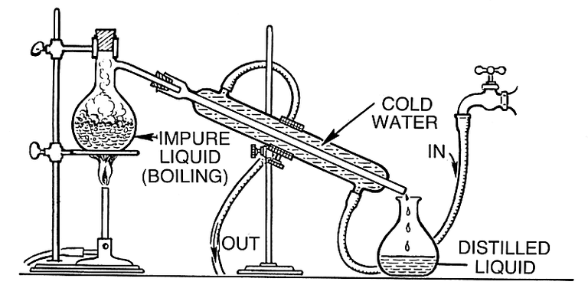


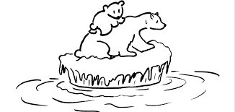

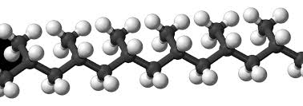

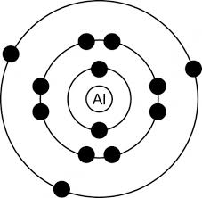


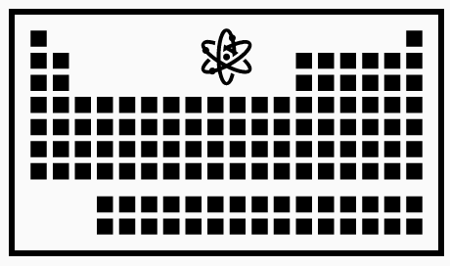

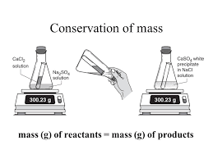
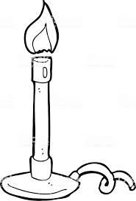

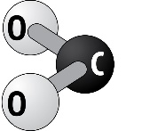
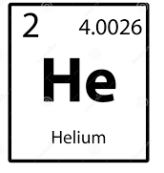
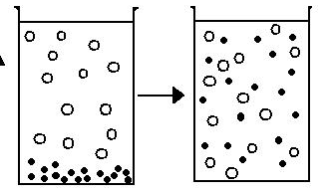
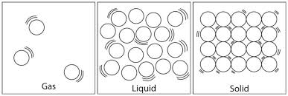
Separate Sciences : Chemistry Learning Journey
Understanding variables
Applying maths to the scientific concepts
Writing
methods
Assessing impact of scientific concepts
Drawing conclusions
Describe patterns
Evaluation of scientific concepts
Year 7
Understanding and Applying Scientific Skills
Year 11
Drawing graphs and analysing graphical data
Analysis of secondary data
Modelling scientific concepts
Understanding relationships between science and society
IDEAL
Identify, describe, explain, apply, link
Risk Assessment
Evaluating data and investigations
H₂
Complete and incomplete combustion of hydrocarbons
Properties of hydrocarbons
Fractional distillation
Final GCSE exams
Climate change
The changing atmosphere
Alternative fuels
Crude oil
Revision
CC17
CC15
YEAR
The atmosphere today
Earths early atmosphere
Thermal and catalytic cracking
Problems with burning fuels
Testing for saturation
Hydrocarbons
11
Metal extraction
Electrolysis
Products of electrolysis
The Haber process
Group 7 – The halogens
Group 0 – Nobel gasses
Reproducibility
Factors affecting rate of reaction
Activation energies
Energy profile diagrams
Calculating concentrations
CC16
Calculating moles
CC10/CC11/CC12
CC13
CC14
Bond energies
Avogadro's constant
Endothermic reactions
Heat energy changes
Conservation of mass
CC9
Displacement reactions
Biological extraction
Half equations
Reversible reactions
Group 1 – Alkali metals
Reactions of group 7 elements
Collision theory
Investigating rate of reaction
Catalysts
Exothermic reactions
Calculations using masses
OH⁻
Calculating empirical formula
Solubility
Alkalis and balancing equations
Bases and
salts
Acids, alkalis and indicators
Properties of metals
Molecular compounds
Ionic compounds
The modern periodic table
Relative atomic mass
Atomic theory
2:1
YEAR
Ionic bonding
Distillation
10
CC8
CC5/CC6/CC7
CC4
CC3
Filtration and crystallization
Electronic configuration
Mendeleev
CC1/CC2
Pure substances
Neutralisation
Preparing copper sulfate
Looking at acids
Bonding models
Allotropes of carbon
Covalent bonds
Ionic lattices
Atomic number and isotopes
Drinking water
H⁺ + OH⁻ → H₂O
H⁺
Chromatography
States of matter
YEAR
Group 1 – alkali metals
Group 7 – the halogens
Group 0 – the noble gasses
Solutions
Filtration
Chromatography
Types of
rock
The carbon cycle
Recycling
Metals &
oxygen
Metal displacement
Ceramics
9
Metals and non-metals
Separation techniques
The Earth
Metals and acids
The periodic table
New technology
nanoparticles
future fuel
Groups and periods
Displacement reactions
Mixtures
Solubility
Evaporation and distillation
The earth and its atmosphere
The rock
cycle
Climate
change
Metals &
acids
Metals &
water
Extracting metals
Composites
Polymers
Detection - CSI
YEAR
8
Endothermic and exothermic reactions
Thermal decomposition
Word equations
Chemical formulae
Atoms
Gas pressure
Boiling
The particle model
YEAR
Turning points
- elements
Acids
Reactions
Elements
Particle model
7
Making salts
Neutralisation
Indicators and pH
Acids and alkalis
Conservation of mass
Burning fuels
Chemical reactions
Compounds
Elements
Diffusion
Melting & Freezing
States of matter
CROSS-CURRICULAR LINKS
Movement
Biology
Isotopes
Physics
Calculating mass
Mathematics
Balancing equations
Biology
The Earth
Geography
Climate change
Biology
Atomic models
Physics
Materials
Art & Design

