Slide 1




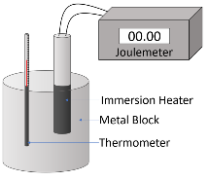




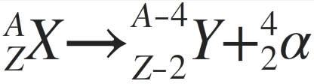
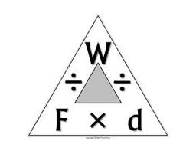
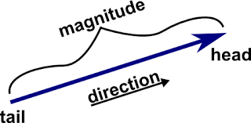





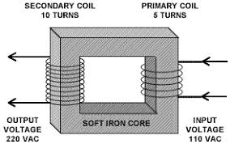

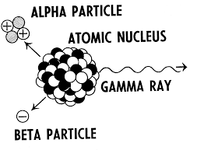

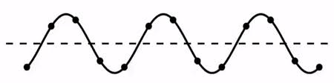



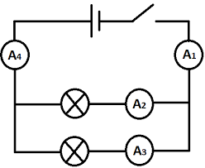






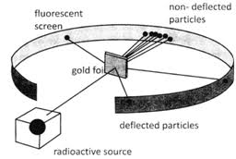




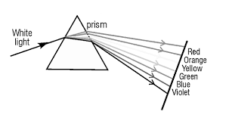

















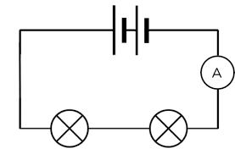


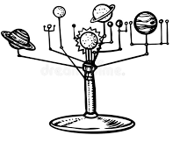





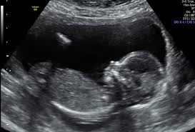
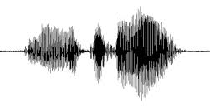


Separate Sciences : Physics Learning Journey
Understanding variables
Applying maths to the scientific concepts
Writing
methods
Assessing impact of scientific concepts
Drawing conclusions
Describe patterns
Evaluation of scientific concepts
Year 7
Understanding and Applying Scientific Skills
Year 11
Drawing graphs and analysing graphical data
Analysis of secondary data
Modelling scientific concepts
Understanding relationships between science and society
IDEAL
Identify, describe, explain, apply, link
Risk Assessment
Evaluating data and investigations
Final GCSE exams
Investigating springs
Gas temperature & pressure
Specific heat capacity
Kinetic energy
National grid
Revision
Forces and matter
Particle Model
EM Induction
Transformers
Bending and stretching
Specific latent heat
Density
Transformers and energy
Magnetic forces
Calculating work done
Resolving vectors
Power/Work done relationship
Magnetism
Electrom-agnetism
Understanding and calculating half lives
Beta decay and nuclear equations
Voltage
Transferring energy
Resistance in circuits
Power
Wiring a plug
Attraction and repulsion
YEAR
Background radiation
Forces Doing Work
Electricity
11
Magnetic fields
Alpha, beta and gamma
Dangers of ionizing radiation
Fields
Calculating power
Current
Resistance
Circuits – parallel and series
Potential difference
Electricity in our homes
AC/DC & electrical safety
Radioactivity
Distance and velocity time graphs
Electrons and orbits
EM radiation dangers
Electromagnetic waves
Ears and hearing
Waves crossing boundaries
Wave calculations
Crash
hazards
Mass and weight
Forces and quantities
Vectors and scalars
Renewable and non-renewable energy
Inside atoms
YEAR
EM Spectrum
10
Waves
Forces and motion
Efficiency
Atomic models
The electromagnetic spectrum
Energy transfers
Using the short and long wavelengths
Infrasound
& ultrasound
Reflection & refraction
Features of waves
Stopping distances
Resultant forces
Momentum
Newton
Acceleration
Kinetic
energy
Gravitational energy
Energy
YEAR
Pressure in liquids
Turning forces
Energy
adds up
Energy transfer - particles
Conduction & Convection
Energy &
Power
Charging up
Potential difference
Magnets and magnetic fields
9
Speed
Motion graphs
New technology - homes, hospitals & more
YEAR
Motion & Pressure
Energy
Electricity
8
Pressure in gasses
Pressure in solids
Energy &
food
Energy &
Temperature
Radiation
Energy resources
Work, Energy and Machines
Circuits & current
Series and parallel
Resistance
Electromagnetism
Detection - planets & alien life
Turning points
The Universe
radioactivity
electromagnetism
Space
Detecting sound
Loudness and pitch
Balancing forces
Speed
Representing forces
The Earth and Moon
Colours
The eye
Reflection
Speed of sound
YEAR
Light
Sound
Forces
7
The solar system
The night sky
The camera
Refraction
Light
Echoes of ultrasound
Waves
Sound and energy transfer
Forces at a distance
Gravity
Identifying forces
CROSS-CURRICULAR LINKS
Isotopes
Chemistry
Energy
Chemistry
Electricity
Engineering
Calculations
Mathematics
Pressure
Chemistry
Radiation dangers
Biology
Atomic models
Chemistry
Detecting light & sound
Biology

