Slide 1




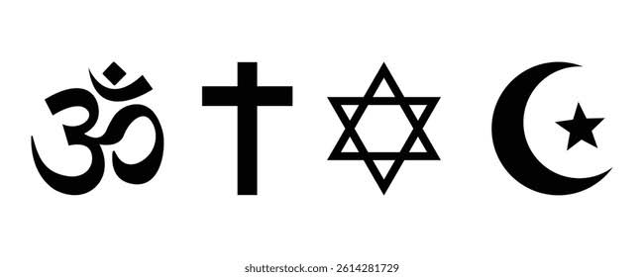




























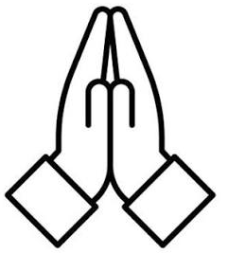

How can we answer the exam questions?
REVISION & PRE-RELEASE
Religious Education Learning Journey - Knowledge
REVISION
What have we learnt?
Revision on Religion and Life (in statutory lessons)
Revision on Islam
YEAR
REVISION
RECAP OF PAPER 2
RECAP OF PAPER 1
11
Revision on Relationships and Family (in statutory lessons)
Revision on Christianity
REVISON
Does living biblically mean obeying the whole Bible?
Why is Allah, an afterlife and the Qur’an so significant within Islam?
How does Islam influence the lives of Muslims?
CHRISTIAN BELIEFS
ISLAMIC BELIEFS
ISLAMIC PRACTICES
Is religion a power for peace or a cause of conflict in the world today?
Living the Christian life
How to Sunni and Shi’a Muslims differ in beliefs?
What must Muslims do to maintain a pious life?
PEACE AND CONFLICT
What can religions do to reconcile after conflicts?
Critical exploration of Islam and Christianity
Should the death penalty still be used today?
YEAR
START OF GCSES
10
THE DEATH PENALTY
Critical exploration of key themes:
Relationships and Family
Religion and Life
Crime and Punishment
Peace and Conflict
What are the religious views on corporal punishment?
How should society deal with criminal actions?
?
CRIME AND PUNISH-MENT
What are religious attitudes towards crime?
How have women contributed to the development of world religions?
How might religion and human rights be interconnected?
Why does inequality still exist today?
ROLE OF WOMEN IN RELIGION
HUMAN RIGHTS AND SOCIAL JUSTICE
WEALTH AND POVERTY
What impact have they had on communities today?
How has faith inspired the work of leaders within religion?
Who has had the largest impact on world religions?
What can religions do to combat inequalities?
What do religions do to close the wealth gap?
RELIGIOUS LEADERS
Do we need religion to be inspirational?
Why should we remember the work of others?
Is life after death the same for everyone?
YEAR
WORLD BELEIFS INFLUENCING ACTIONS
9
YOUR INSPIRATIONS
LIFE AFTER DEATH
Who is inspirational to you?
What makes an individual inspirational?
What influences your afterlife according to religious beliefs?
What do Abrahamic religions believe about life after death?
DEATH: IS IT THE END?
What do Dharmic religions believe about life after death?
What are the most important features of a festival?
Are all the ideas of religion and science incompatible?
Is God an impersonal being?
YEAR
RELIGIOUS EXPRESSION
8
MORE QUESTIONS, THEN ANSWERS
PHILOSOPHY OF RELIGION
Are non-religious festivals as important as religious festivals?
Create your own festival
Is religion still necessary today?
How might the problem of evil and suffering impact belief?
RELIGIOUS FESTIVALS
How do religious believers celebrate or commemorate their beliefs?
How do religious believers show their faith in places of worship and beyond?
What is it like to be a member of a particular religion in Britian?
How does RE help us understand the world?
What do new Year 7 students already know?
YEAR
RELIGIOUS WORSIP
RELIGION IN BRITAIN AND BEYOND
WHAT IS RELIGIOUS EDUCATION?
BASELINE ASSESSMENT
7
What type of worship do we see in modern Britain?
Are we becoming an increasingly religious or non-religious world?
Why is RE important?
What do we need to build on this year?
Welcome!

