Slide 1

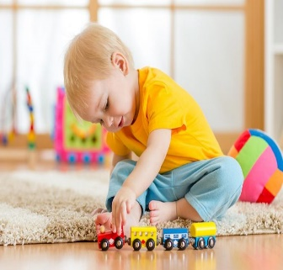
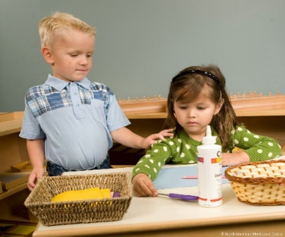
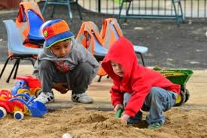
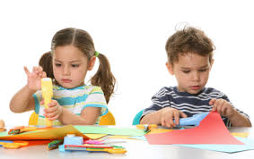
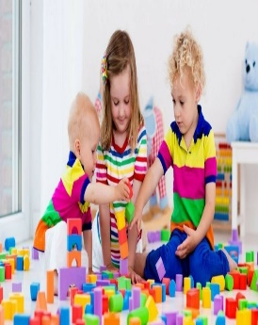
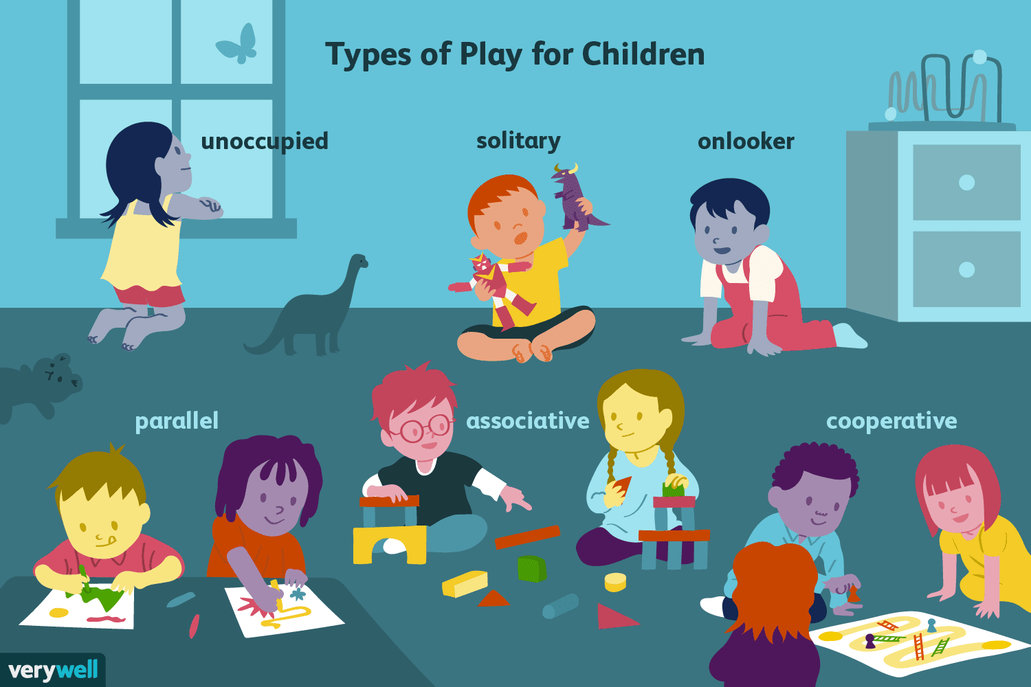






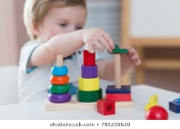

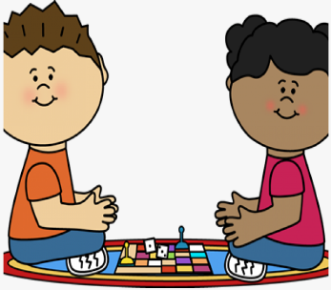
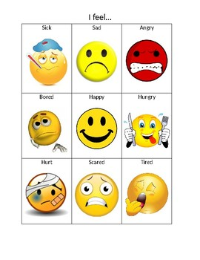


Knowledge Organiser
A: Understand how children play
Learning through play
Child Development
BTEC Technical Award - Component 2
A1: Stages of children’s play
A2: How play can be organised to promote learning
1
2
3
Key Concepts
Adult-led play
Adults plan, organise and lead the children in a play activity
Can include higher risk activities and how to use resources and equipment safely. The adult can introduce new vocabulary.
Learning is limited to the adult’s choice of activity and time given to it, limited repetition of the activity to enhance learning new skills.
Adult-initiated play
Adults put out resources and toys that prompt children to play in a certain way.
Encourages children to try playing in new ways and develop new skills, more effective for promoting independent learning skills.
Children may not learn expected skill or concept
Child-initiated play
Children choose resources and how to play with them
Children can develop their own ideas more freely, increased opportunities for the development of social skills
A child may focus on one area of learning or development repeatedly, ignoring others, learning may be limited without an adult to expand on learning opportunities.
6
5
4
A3: The role of adults in promoting learning through play
Organise a variety of activities:
Inside/outside activities
Individual/group activities, including games
Sensory activities, art and craft activities, games
Explaining and demonstrating how equipment and resources work
Adapting activities to suit personal interests
Choosing equipment and resources that motivate children to engage, explore, question, challenge and allow time for these activities
Modelling communication – use of language
Joining in with play activities – promoting sharing and turn taking
Awareness of health and safety- toys and resources are age appropriate and used appropriately by the child
Key terms:
1- Unoccupied play → from birth to 3 months. Movements with arms, legs, hands, feet etc. Learning how their muscles move
2- Solitary play → birth -2 years. A child plays alone
3- Onlooker play→ 2 years. A child watches other children play but does not play with them
4- Parallel play→ 2+ years: a child starts to interact with others during play but there is not a large amount of interaction
5- Associative play→ 3-4 years: a child starts to interact with others during play but there is not a large amount of interaction
6- Cooperative play → 4+ years: a child interacts fully with others and has interest in both the activity and the other children involved.
B2: Demonstrate how children’s learning can be supported through play
B6: Emotional play and learning
Planning play opportunities
B1:How learning through play can occur during planned activities in the following environments: at home, in nurseries, preschools, reception school classes, community-based groups.
Learning through emotional play:
Expression of feelings, including teaching children how to self-manage emotions and behaviours
Promote independence
Improve self-confidence, self-esteem and self-awareness
Build on relationships
Activities and resources to support emotional play and learning:
Puppets and dolls
Role-play dolls
Emotion faces, ‘how I feel today’ mirrors
Circle time/carpet time
B4: Communication and language play and learning
Physical play and learning
Age groups:
0-18 months
18 months – 3 years
3-5 years
B3: Cognitive and intellectual play and learning
Learning through communication and language play:
listening skills – including refining speech sounds through interaction with others
vocabulary and literacy skills, including speaking and questioning skills how to express and discuss feelings appropriately
understanding of others’ experiences, e.g. cultural experiences such as religious festivals
activities and resources to support communication and language play and learning
books – lift-the-flap books, textured, stories, talking books, story sacks role play, e.g. dressing-up clothes
nursery rhymes and songs, e.g. Miss Polly had a Dolly, Twinkle Twinkle Little Star
action games, e.g. follow the leader, hide and seek
listening walks – use of the outside environment
cooking and baking activities – the process of following instructions.
spatial awareness – eye coordination, foot and leg coordination, hand-eye coordination
activities to stay healthy
how to take care of yourself
gross motor skills – body management, strength, bodily coordination
fine motor control – accuracy and manipulation of objects.
Learning promoted through cognitive and intellectual play:
Problem-solving skills
Creativity
use of imagination
listening and attention skills
numeracy skills
exploration of environments inside and outside confidence using technology
Activities and resources for physical play and learning:
role play of home life situations (e.g. cooking, mealtimes, baby bath time)
food preparation, snack times, hand washing
bat and ball games
tricycles, bicycles, sit-and-ride toys
climbing frames, swings, slides
creative activities – crayons, pens, paint brushes, paper, scissors, needles, threads, beads playdough, sand and water activities construction toys, e.g. small bricks, small-world toys.
Activities and resources for cognitive and intellectual play and learning:
Counters, weights and play money
Shape sorters, puzzles, matching-pair card games
Trips and visits, e.g. Park, zoo, woods
Digging and building
Computer games, apps, PCs, tablets
Writing- wipe boards
B5:Social play and learning
Learning through social play:
Development of friendships and relationships- build bonds, trust, emotional support networks
Sharing, turn taking, compromise
Understanding of culture and values
Activities and resources to support play and learning:
Team games and activities
Group projects such as gardening
Role play
Board games

Slide 2


