Slide 1
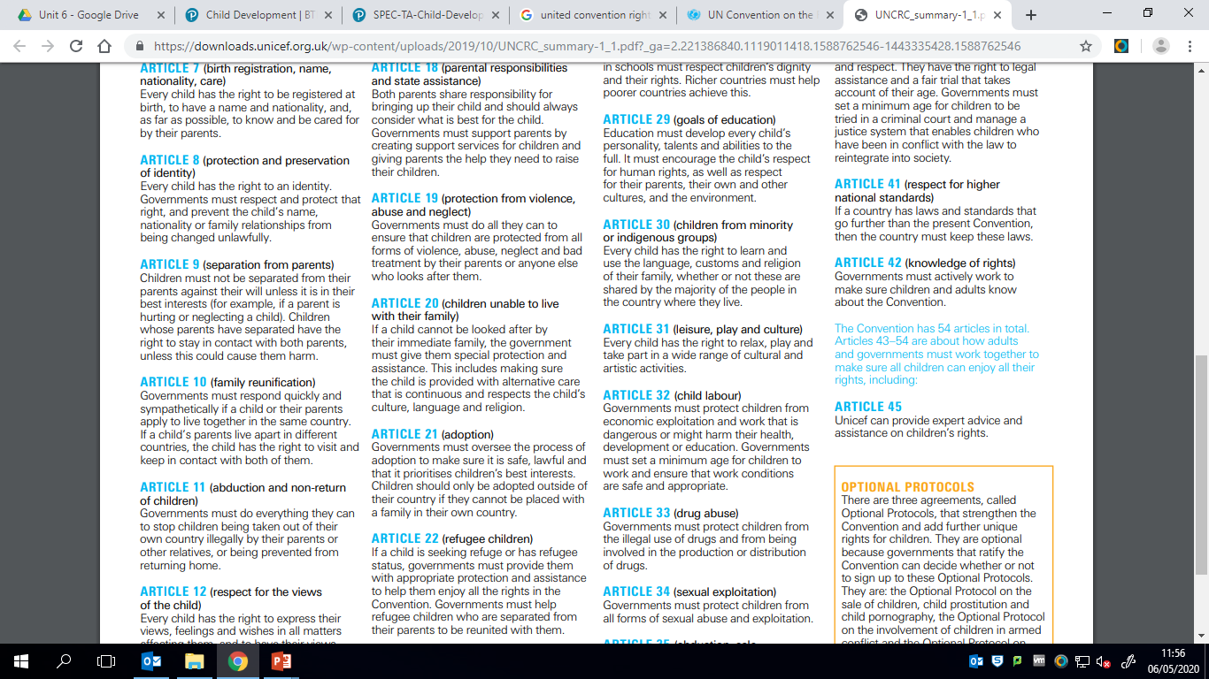
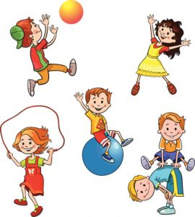
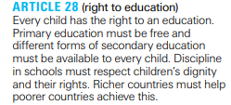

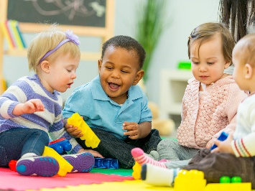

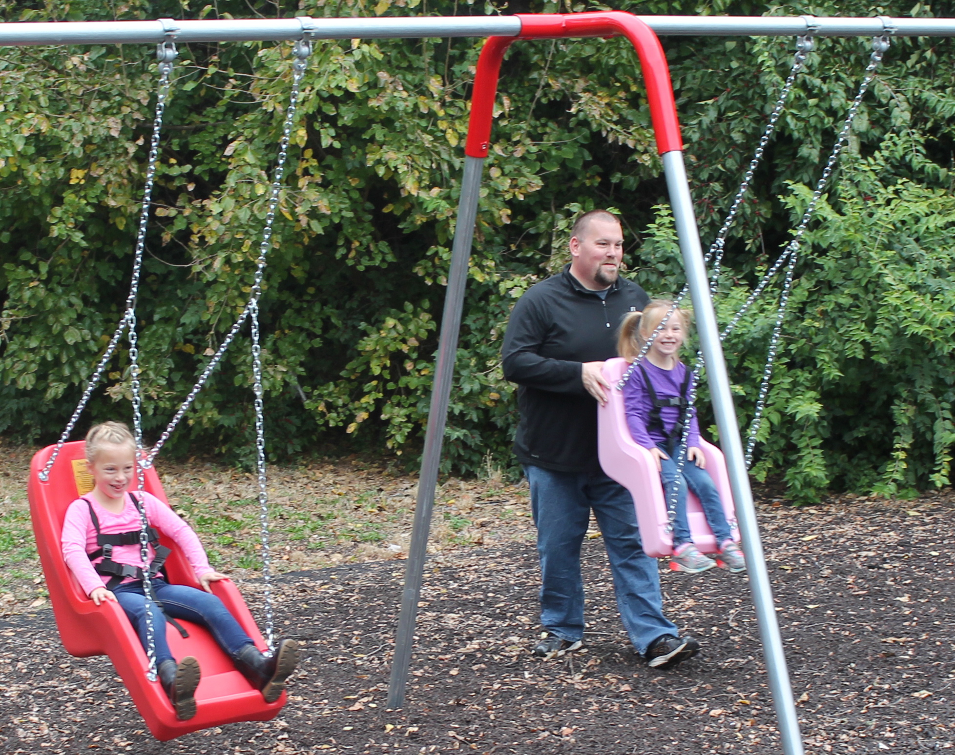
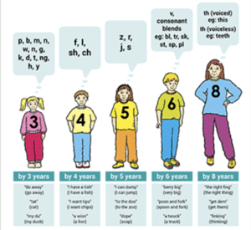
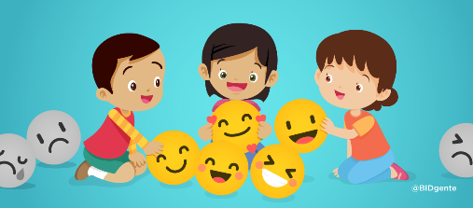
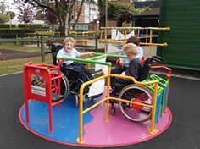

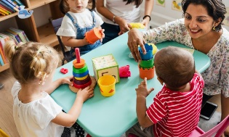
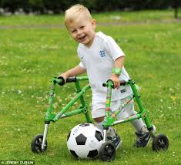
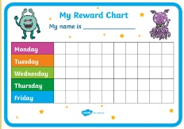
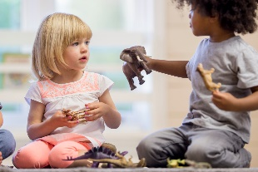

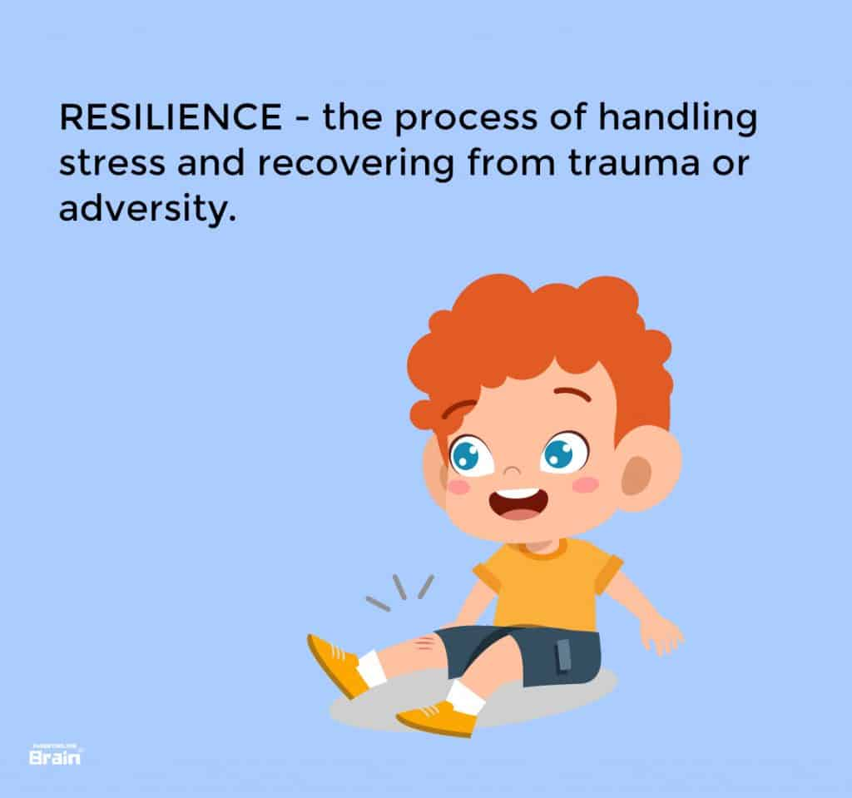
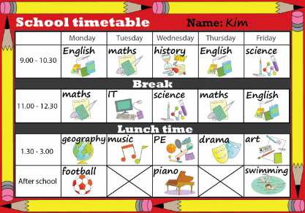
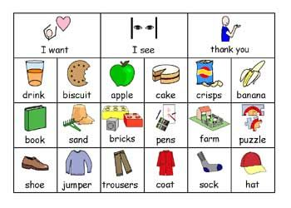
Knowledge Organiser
Component 3: Supporting Children to Play, Learn and Develop. Learning aim C: C Adapt play to promote inclusive learning and development
Child Development – Adapt play to promote inclusive learning and development
BTEC Technical Award - Component 3
C1 The benefits of adapting activities for all children in play, learning and development
Promote all 5 areas of development for all children
Physical development
Cognitive and Intellectual development
Recognition that every child has a right to learn – United Nations Convention on the Rights of the Child.
Social development
C2 Adapting activities/resources to support a child with physical needs (as appropriate to the age group)
Emotional development
Communication and Language development
Adapting activities/resources to support a child with physical needs (as appropriate to the age group)
Make adjustments to the environment – sufficient space is available to carry out the activity, adjust the amount of lighting available to improve visibility
Choose resources that are age and stage appropriate.
Select appropriate resources that all children can use, including resources for grasping, holding, releasing and transferring
Secure movable objects so they do not move – use tape to secure paper, mixing bowls or wood blocks to the table or floor so they remain in place as the child paints, draws, stirs or hammers.
Adjust the level of activities and resources to suit the child’s needs (visual impairment, hearing impairment, physical issues)
Provide materials and resources for sensory needs, including use of contrasting colour schemes, 3D art materials, use of scents and textures
The role of the adult:
promote inclusion – ensure all children can join in organised activities
role-model desired behaviours when interacting with children who have additional needs
give children a choice when planning and choosing activities
respond positively to desired behaviours in children, using praise and rewards
recognise when children are becoming bored, losing concentration, finding activities too difficult.
It is important to give children choices when an adult plans and chooses activities.
Children should be allowed to plan their own activity and choose materials.
Giving them choices allows them to learn to make decisions for themselves and develop independence.
Children tend to respond positively to praise. If children are praised then they tend to repeat the behaviour. Praise is a way of expressing approval
Can you link to areas of development?
C3 Adapting activities to support a child with cognitive and intellectual or communication and language needs (as appropriate to the age group)
Provide opportunities to learn and play near to other children doing the same activity – encourage sharing of ideas. • Shorten activities to suit concentration span. • Use peers or other adults to model activities. • Break activities down into short steps – repeat steps as necessary. • Modify toys and equipment to suit individual needs – reduce number of parts, remove items that are too small, use specific colours. • Limit the number of materials available to avoid overwhelming the child. • Use technological/digital resources as appropriate
Benefits to other children:
they learn how to include others in their games and activities
promotes positive behaviours – improves social skills; sharing of resources
they become more responsive to the needs of others – communication methods, impact of behaviours such as sudden noises or movements
C4 Adapting activities to support a child with communication and language needs (as appropriate to the age group)
• Use group and/or team activities to promote social inclusion – encourage friendships with other children, build bonds and trust with adults.
• Build confidence in own skills.
• Use alternative communication:
Picture Exchange Communication System® (PECS) – starting with simple words, building to sentence structures
Makaton – signs and symbols to support speech or be used in place of speech.
• Use nursery rhymes with actions to promote identification of words, including songs where words and actions are repeated.
• Label equipment – use picture cards to encourage independence and choice
• Display routines and activities as pictures.
C5 Adapting activities/resources to support a child experiencing social and emotional needs
• Promote self-resilience – limit the choices of activity available so a child does not feel overwhelmed, provide activities that will help the child feel capable. • Provide a structured approach – assign specific tasks to the child during the transition to reduce their worry. • Maintain engagement of the child by filling tidying-up periods with short activities. • Set out activities that focus on a child’s areas of interest – choosing books and games that include the issue that is worrying the child. • Promote choice and control over the environment by providing a range of materials and resources that can be used to complete an activity. • Encourage expression of thoughts, feelings and ideas – use pretend play activities, including dressing-up clothes and role play, cooking materials, use of puppets and dolls. • Encourage group activities – builds confidence in participating with other children; encourages sharing and turn taking.

