Slide 1


Welcome
"Alone we can do so little; together we can do so much"
~ Helen Keller

Slide 2

30 school weeks until GCSEs 2027

Slide 3

Today’s session
Overview of year
Year 11 baseline report
Effective revision introduction
How to support your child in:
  Maths
  English
  Science
Homework
In school support
Post 16

Slide 4
The importance of high attendance.
They need to be in everyday!
Historical attendance | Average Grade
95% + | 5.2
90-95% | 4.7
Below 90% | 2.5
Below 50% attendance | 0.5

Slide 5
Year 11 Key dates
9th – 20th November 2026 | Year 11 Mocks 1
19th November | Sixth Form open Evening
10th December | Mock Results afternoon
14th January | Year 11 Parents evening
8th -26th February (either side of Half term) | Year 11 Mocks 2
17th March | Mock Results afternoon
April – Dates to be confirmed | Languages Speaking exams
10th May | GCSE exams start
23rd June | GCSE Exams end
June – date to be confirmed | Leavers assembly
2nd July – date to be confirmed | Prom
19th August | GCSE Results Day

Slide 6
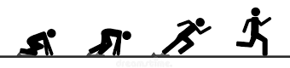
Mock Exams – Start 9th November
4 weeks to make a difference!
Year 10
Mocks
Year 11
Mock 1
Year 11
Mock 2
Final summer exams
Each Mock session is a stepping stone to the final exams – improve each time and peak at the end of the race

Slide 7
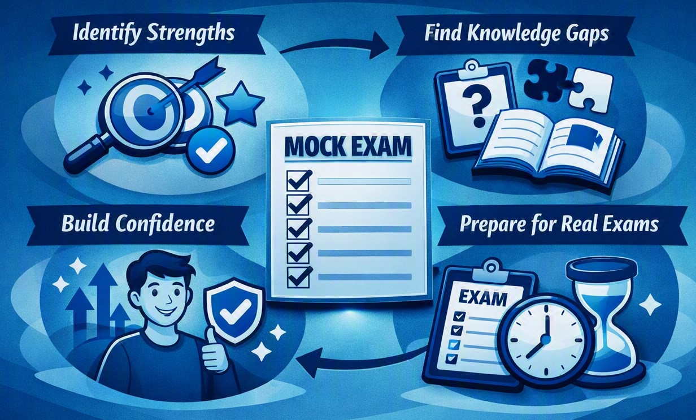
Why do we do mock exams?

Slide 8
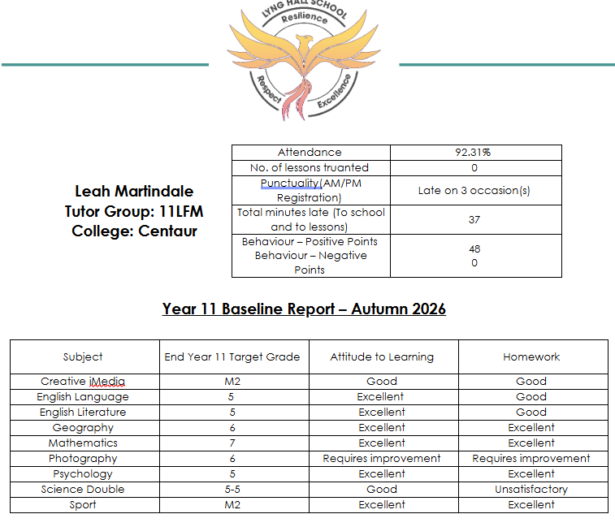
Year 11 baseline report – How do I use the report to support my child?

Slide 9
Year 11 baseline report – How do I use the report to support my child?

Slide 10

Year 11 baseline report – How do I use the report to support my child?

Slide 11
Year 11 baseline report – How do I use the report to support my child?

Slide 12

Small habits, big results
Revise for 15 minutes per day
5 times a week
= over 65 hours of revision before Easter

Slide 13
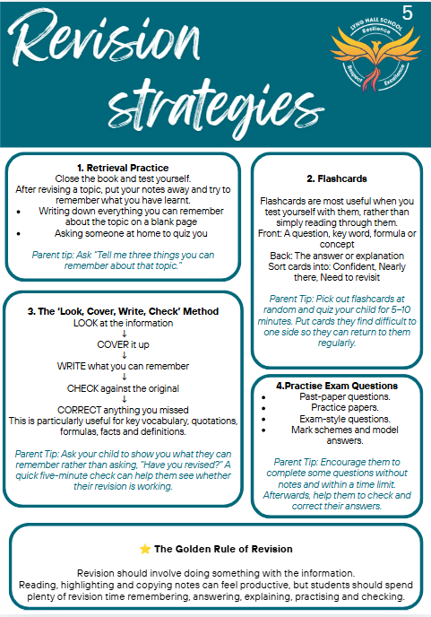

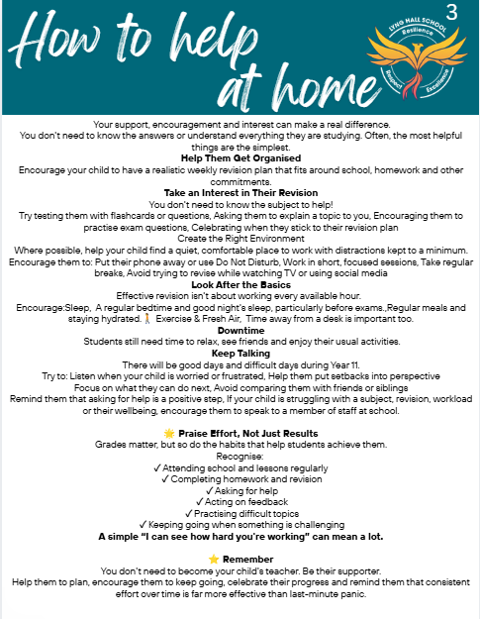

Slide 14
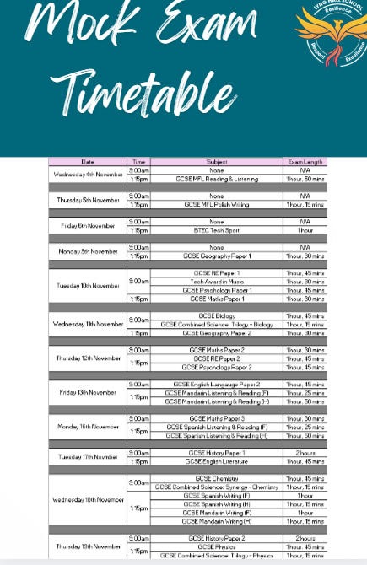
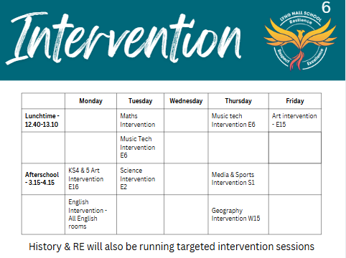

Slide 15


Year 11 Maths

Slide 16
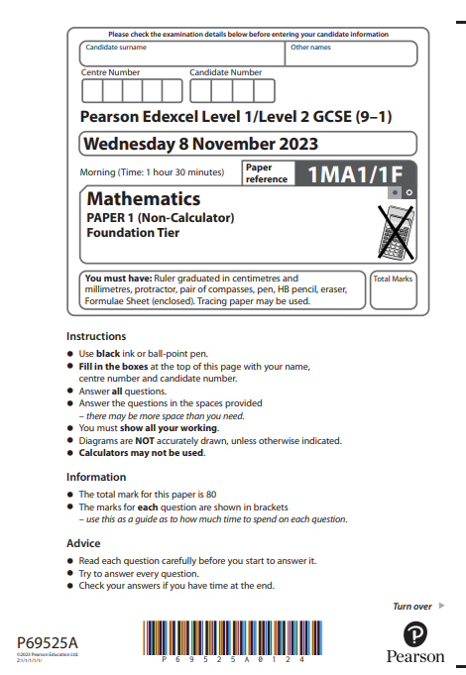
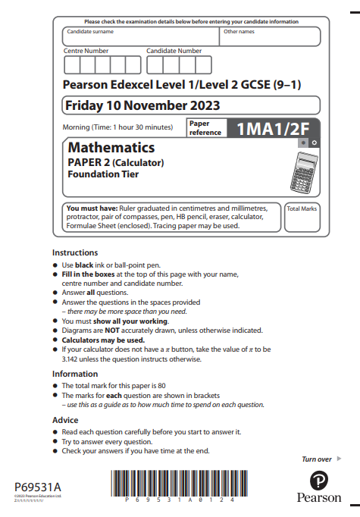
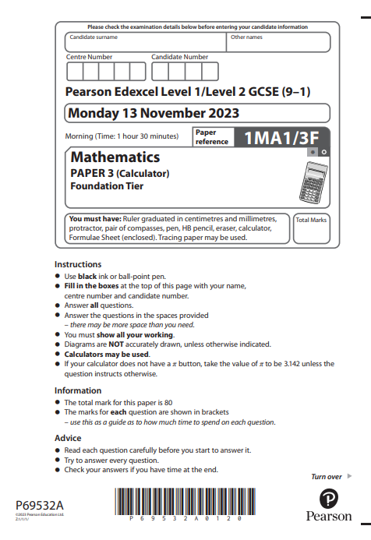
Exam Structure
Exam board – Edexcel
Three papers – one non calculator and two calculator papers
Each paper is 1 hour 30 minutes and worth 80 marks each
Exam Dates
Friday 14th May
Thursday 27th May
Monday 14th June

Slide 17
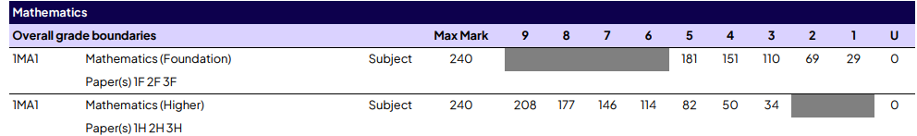
Exam Tiers
Higher Tier – Miss Odams and Ms Muresan’s classes
Foundation Tier – Mrs Glancy, Ms Bindi, Mrs Ghattoura and Ms Mathews
This is the combined total from all three papers.
Grade boundaries increased slightly this June.

Slide 18

Revision- lunchtime on Tuesday in w7

Slide 19
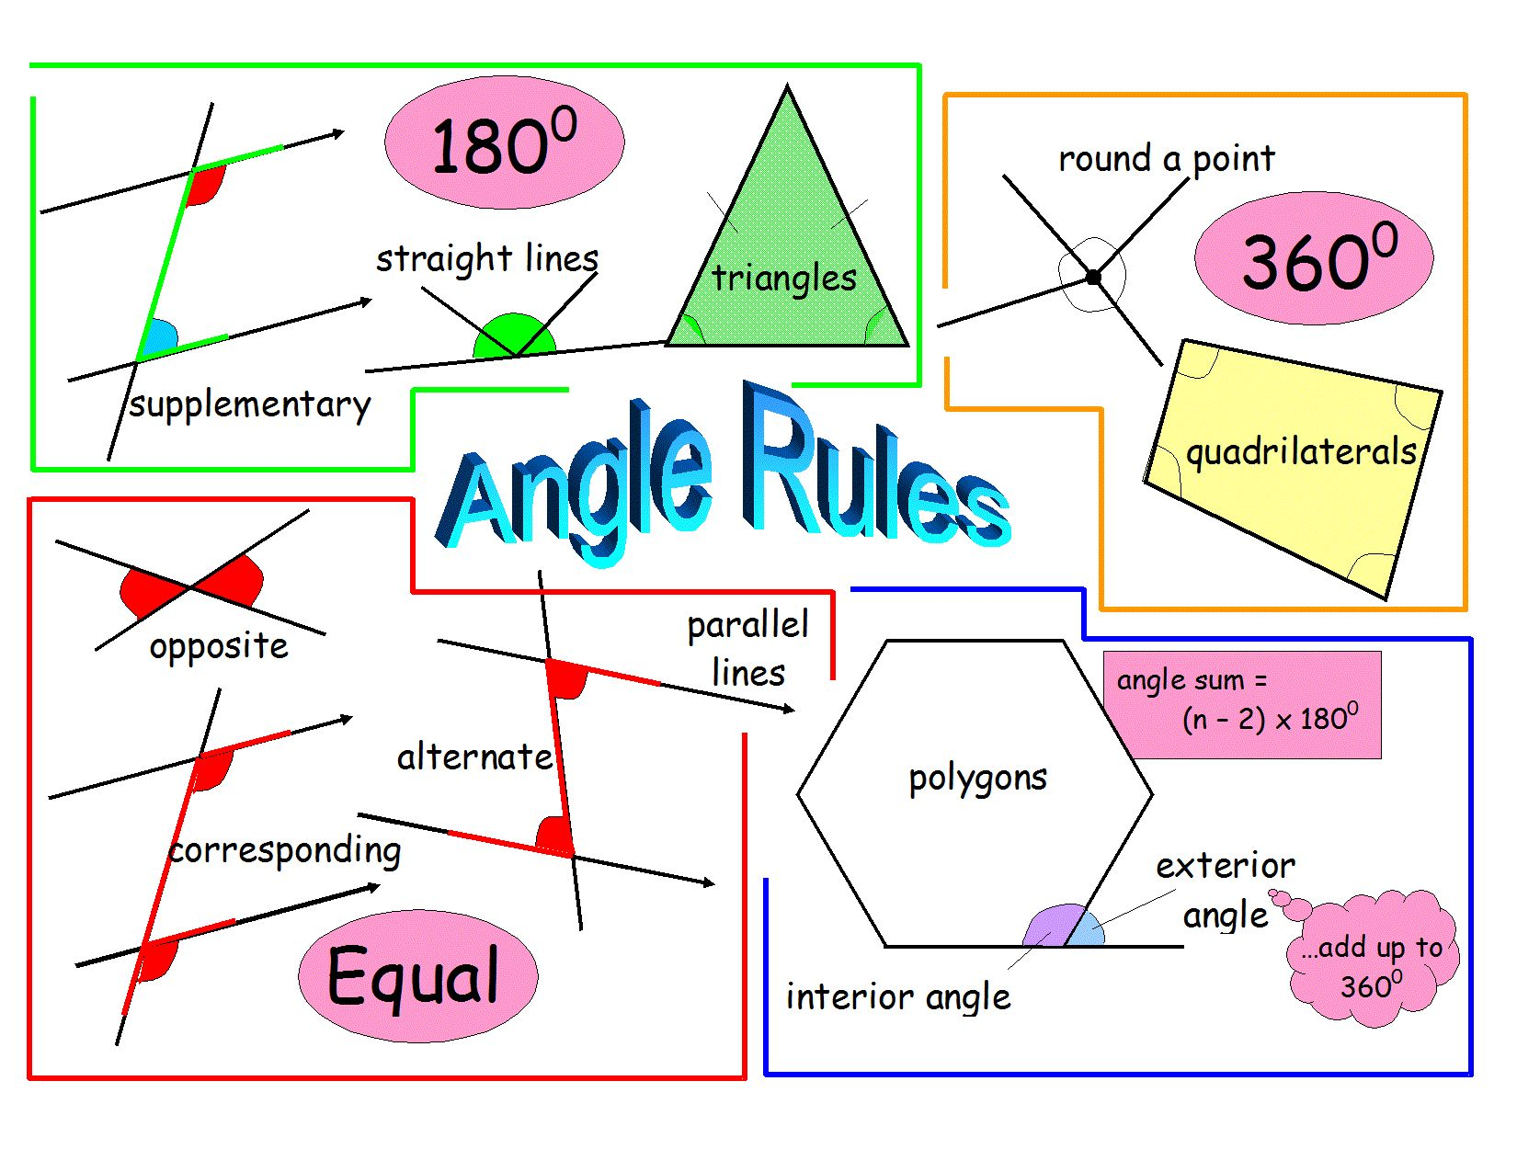
Key areas of focus
Geometry and Algebra questions across both tiers need focus.
Use Maths videos from Maths Genie to review:
Area, volume and perimeter
- Angles in shapes
- Angles in parallel lines
- Angles in polygons
Expanding and factorising brackets
Solving equations
www.mathsgenie.co.uk
Past paper practice – complete as many papers based on their tier as possible. Complete the questions and watch the videos for solutions.

Slide 20
If pupils do not pass this year…….
Pupils who do not achieve a Grade 4 will either:
Resit in Year 12/13 until they pass (Grade 3)
Complete a Functional Skills Maths Level 2 course (Grade 1 and 2)
Supporting your child to pass this year is really important.

Slide 21
Revision resource for use at home.
Maths Genie – www.mathsgenie.co.uk
GCSE Revision tab
For a detailed breakdown of topics which fall within each grade There are videos for each topic, GCSE questions and solutions for students to practice. It is important to note that students need to know all of the previous grades topics to ensure they are securing their grade.
GCSE Papers tab – Edexcel Exam Papers
The link contains:
- past exam paper and mark schemes so pupils can identify where they gain marks
- model answers written on to the exam papers
- videos which talk students through how to answer each question.
Other useful resources –
www.corbettmaths.co.uk – videos, worksheets, solution
www.hannahkettlemaths.co.uk – offers free half past paper exam paper practice on a Thursday on Youtube and Tiktok

Slide 22
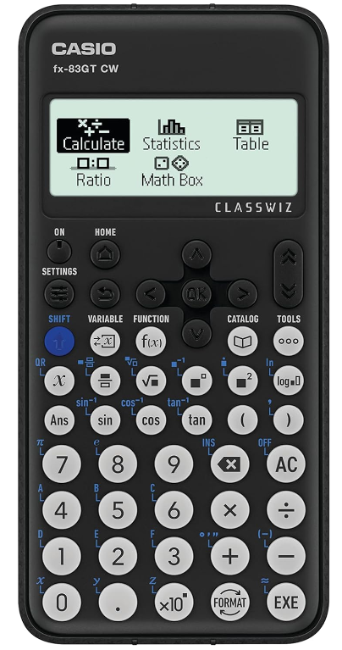
Get a calculator
Your calculator has so many functions to help you.
Casio FX-83GTC - £11 from Amazon.

Slide 23


Revision Guides
Available in Higher and Foundation
For pupils currently working at a Grade 3/4

Slide 24
Top 3 tips:
Ensure your child practices Maths questions little and often. Ten minutes per night watching a Maths Genie video
Get your child to practice as many past papers as possible using www.mathsgenie.co.uk
Ensure your child brings in extra work that is completed at home for their teachers to mark.

Slide 25
Year 11 English

Slide 26

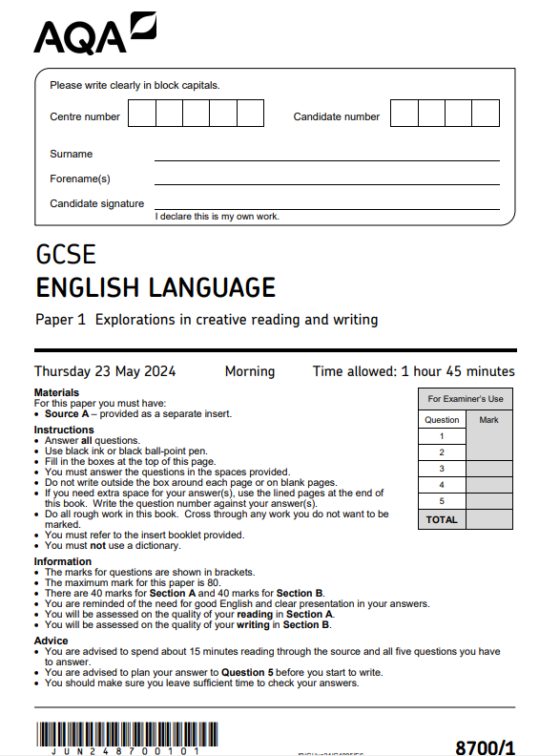
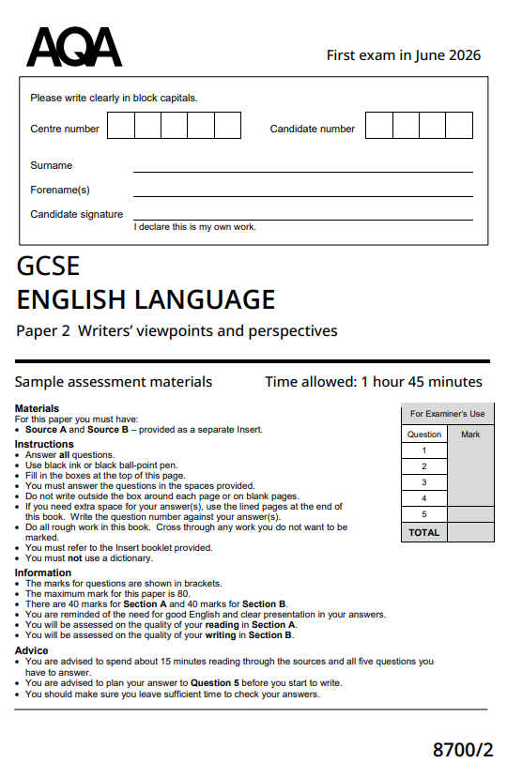
English Language
AQA
Section a – reading section -
40 marks –
4 questions
Paper 1 – Explorations in Creative Reading and Writing
Paper 2 – Writers' viewpoints and perspectives
Section b –writing section -
40 marks –
1 question

Slide 27
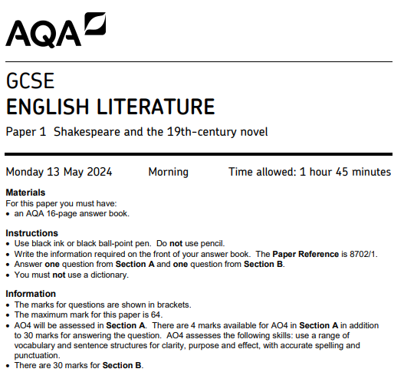
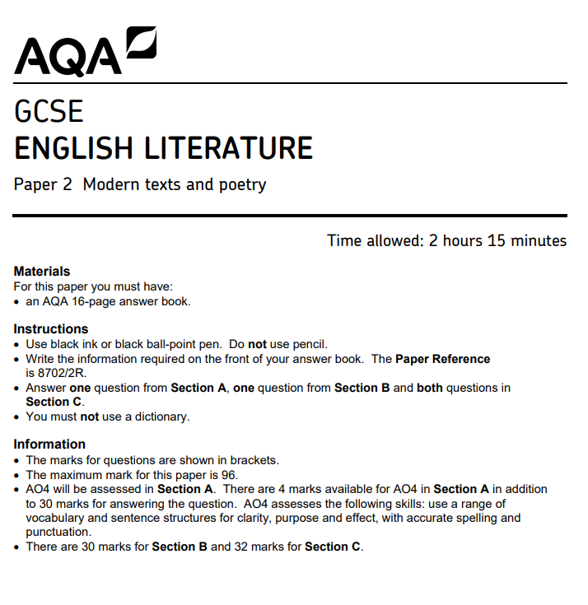
English Literature
AQA
30 marks for each essay
Ao1 – argument/personal response
Ao2 – close analysis
Ao3 – context and concept
30 marks for section a & B
SECTION C – UNSEEN POETRY
24 MARKER – 1 POEM
8 MARKER - COMPARISON
Paper 1 – Macbeth and A Christmas Carol
Paper 2 – An Inspector Calls, Seen Poetry and Unseen Poetry

Slide 28
When can students revise?
Monday Period 6
KS4 Intervention

Slide 29
Key Tips for success
You are your greatest strength
Don’t leave your revision to the last minute. Small nuggets every day.
Interleave your topic revision to support you in shifting between questions on a paper.
Stamina – practice timed question. Pace and timing is your greatest asset.
COMMON MISCONCEPTION –
Examiners want to hear your PERSONAL INTERPRETATION not a translation of a Social Media analysis, or a memorised revision guide.

Slide 30
Year 11 Science

Slide 31
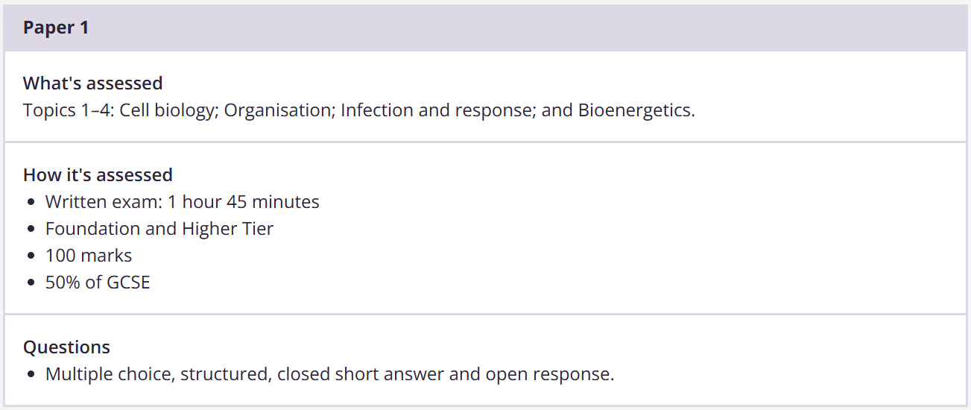
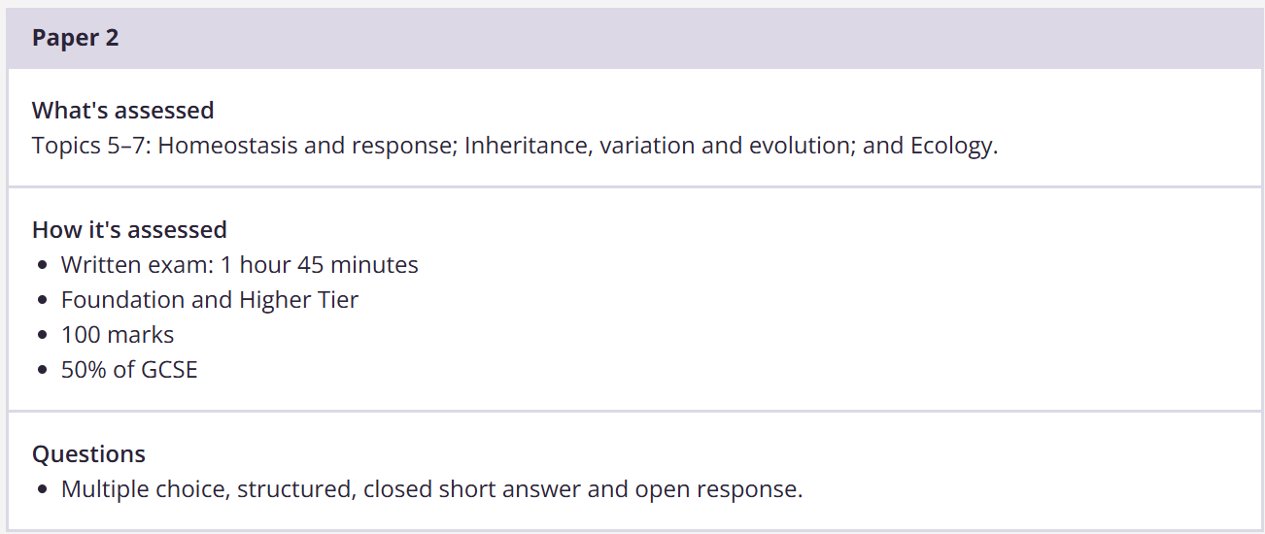
AQA Science Biology Overview
4 Topics Assessed in Paper 1
Cell Biology
Organisation
Infection and Response
Bioenergetics
3 Topics Assessed in Paper 2
Homeostasis and Response
Inheritance
Inheritance, Variation and Evolution
Double Science students sit 1hr 15 minute papers

Slide 32
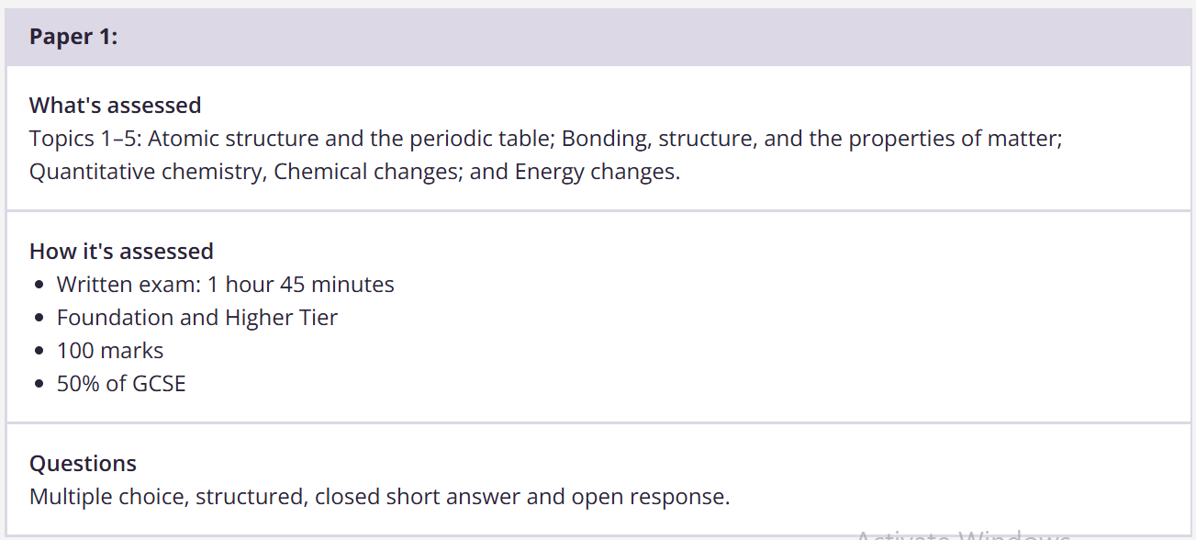
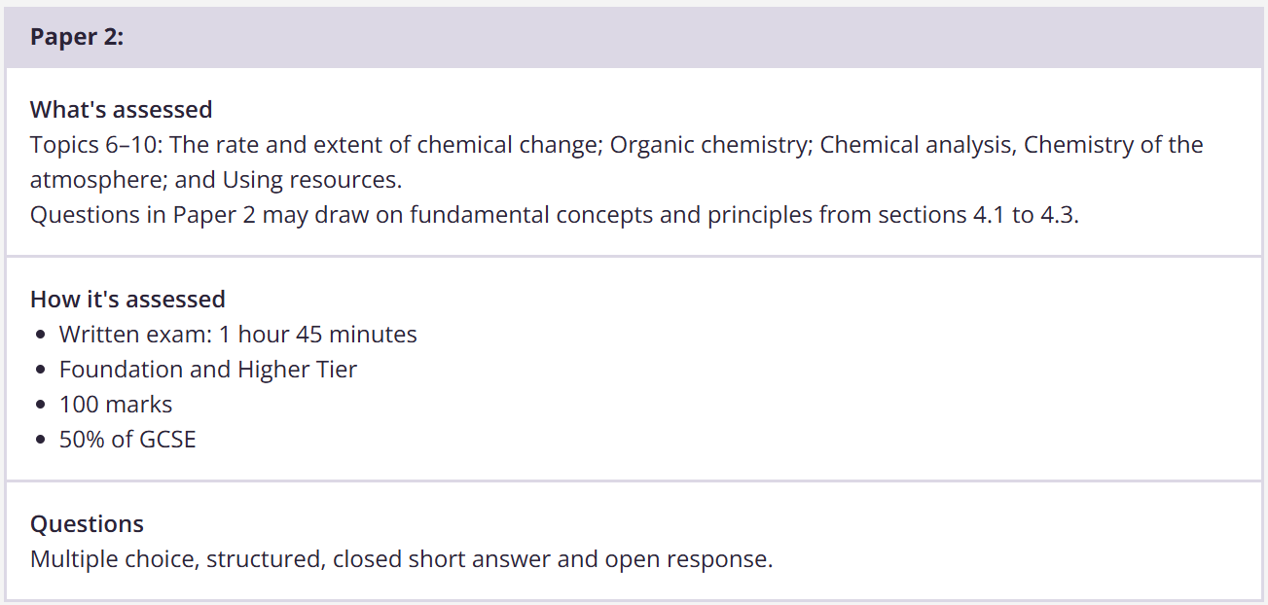
AQA Science Chemistry Overview
5 Topics Assessed in Paper 1
Atomic Structure & The Periodic Table
Structure and Bonding
Quantitative Chemistry
Chemical Changes
Energy Changes
5 Topics Assessed in Paper 2
The Rate and Extent of Chemical Change
Organic Chemistry
Chemical Analysis
Chemistry of the Atmosphere
Using Resources
Double Science students sit 1hr 15 minute papers

Slide 33
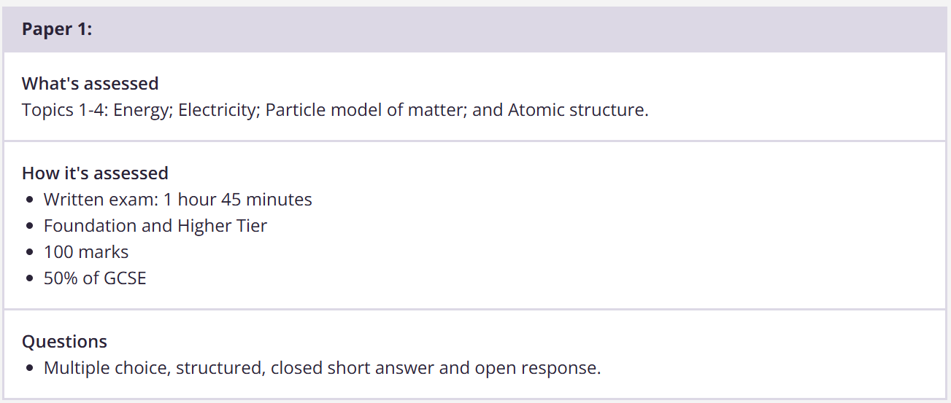
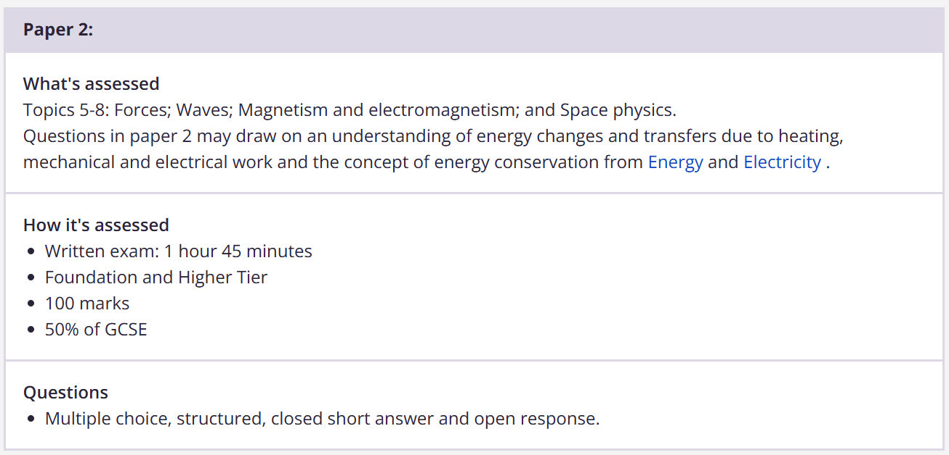
AQA Science Physics Overview
4 Topics Assessed in Paper 1
Energy
Electricity
Particle Model of Matter
Atomic Structure
4 Topics Assessed in Paper 2
Forces
Waves
Magnetism and Electromagnetism
Space Physics
Double Science students sit 1hr 15 minute papers

Slide 34
Coming Soon - Science Intervention
Period 7 Science Intervention every Tuesday – Combined Science
Period 7 Triple Science Intervention with Mr Van Den Topp every Friday
1 hour after school to work with your class teacher on your weakest areas, receive additional support and recap or recall key powerful knowledge.

Slide 35

Revision Guide
Required Practicals
Past Papers

Slide 36
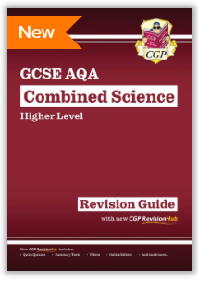

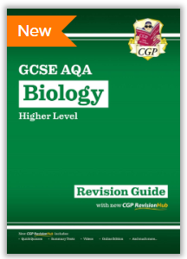
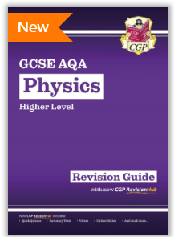
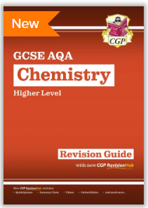
Revision Guides…
Remember : Exam Board AQA
Combined Science Trilogy or Biology, Chemistry, Physics for Triple Science students

Slide 37

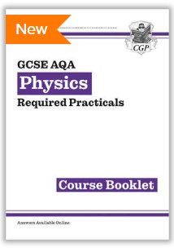
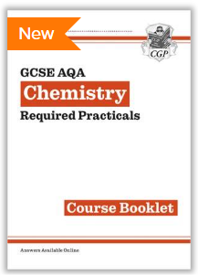
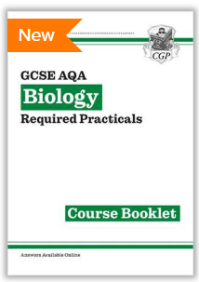
Required Practical Activities

Slide 38





Great online resources
BBC Bitesize (AQA Trilogy Science)
https://www.bbc.co.uk/bitesize
Free Science Lessons
https://www.freesciencelessons.co.uk/
Study Rocket
https://studyrocket.co.uk/
Seneca Learning
https://senecalearning.com/en-GB/

Slide 39

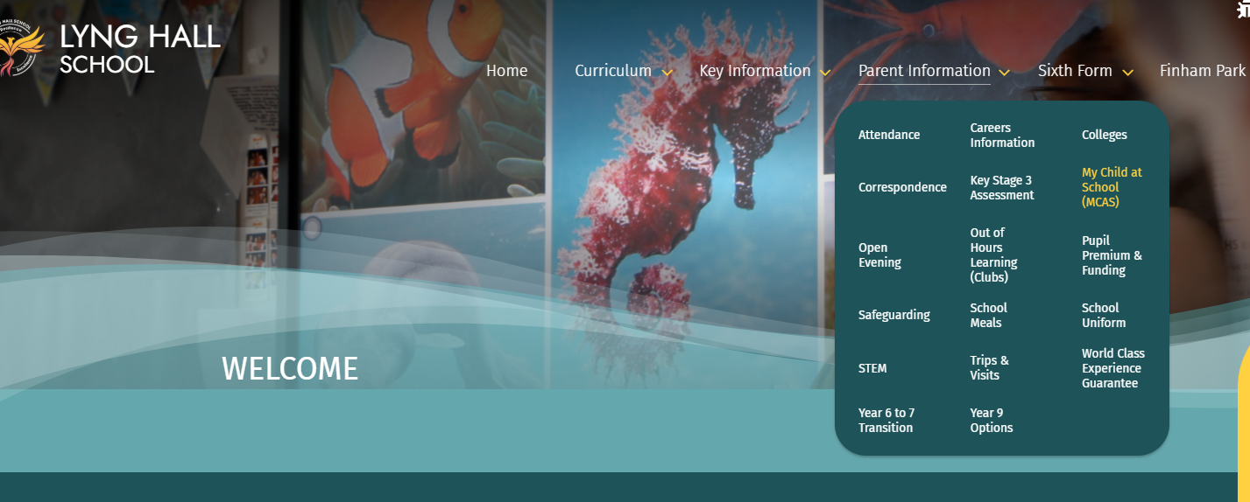
My Child At School​
​
HOMEWORK​

Slide 40


Slide 41
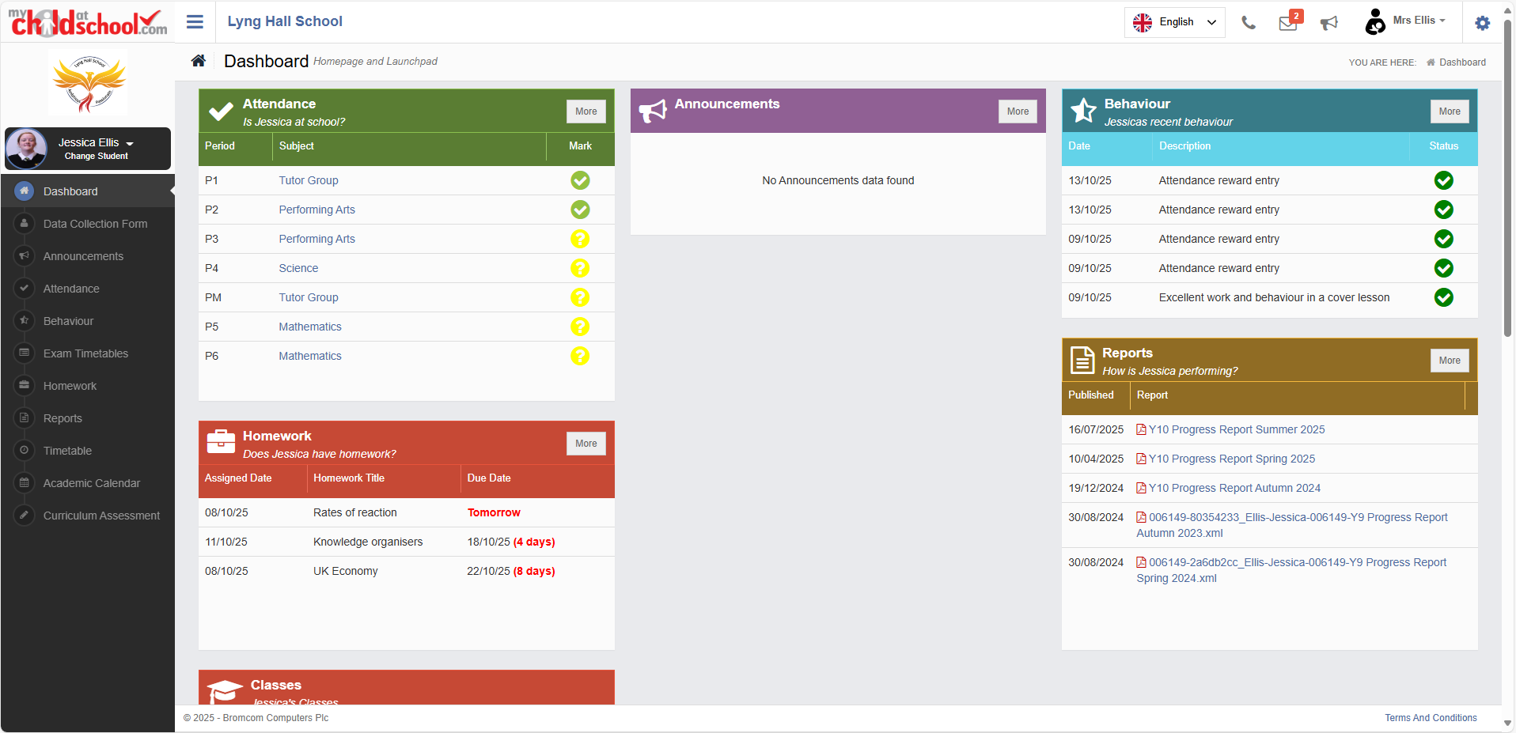

Slide 42
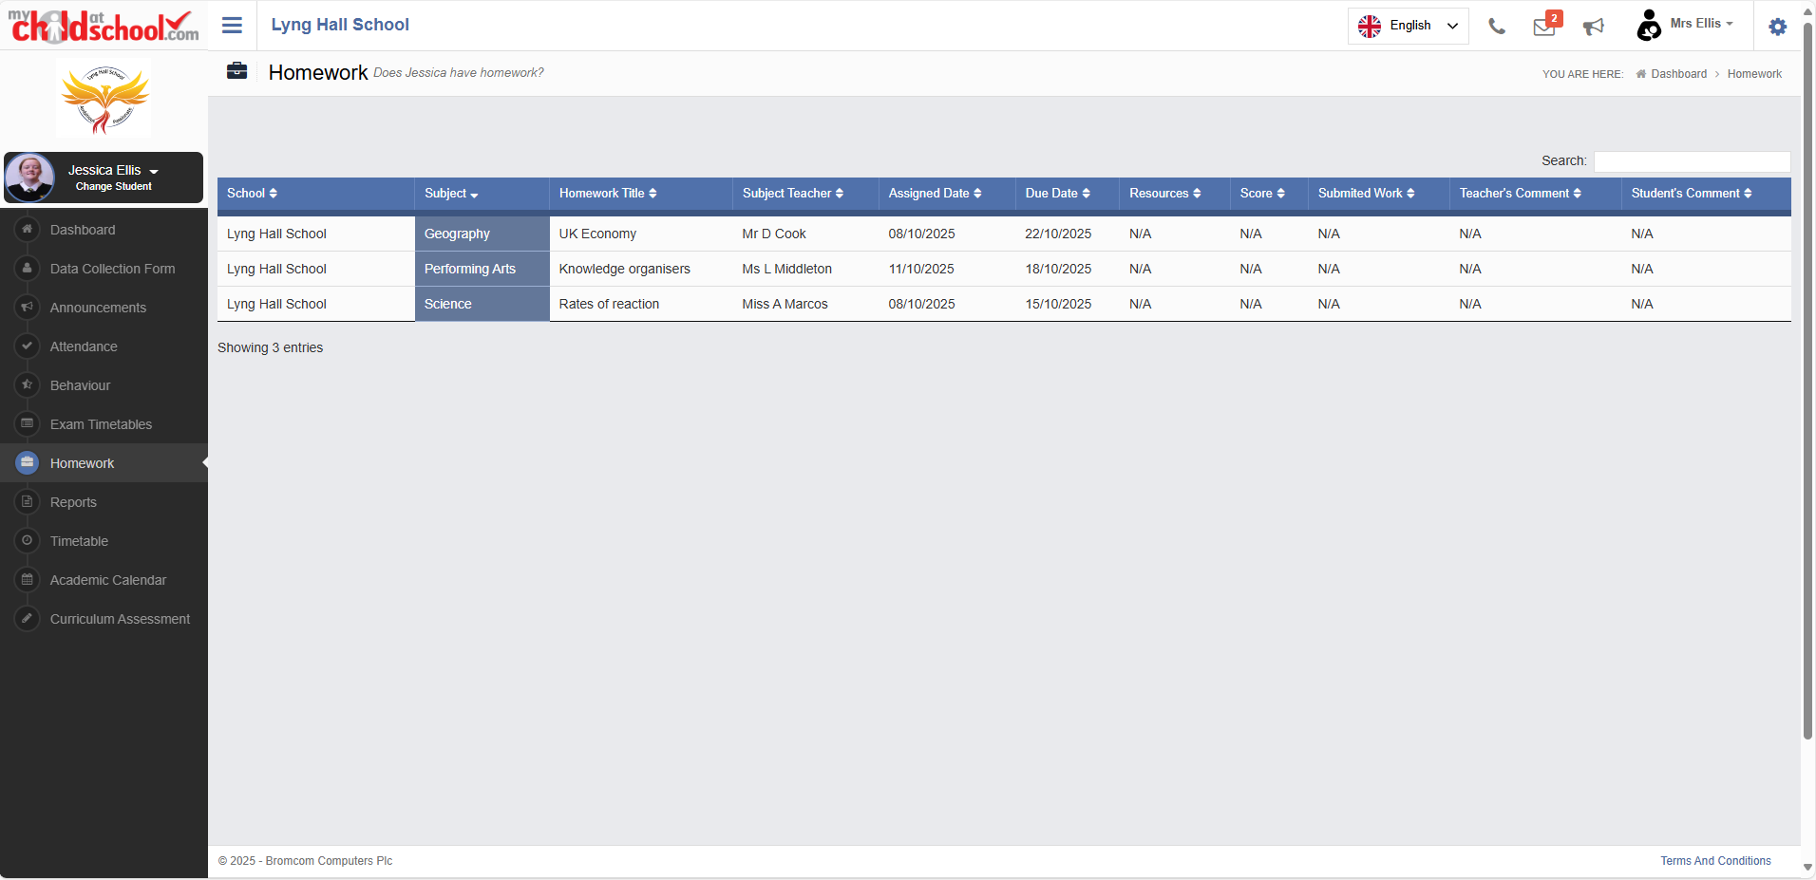

Slide 43
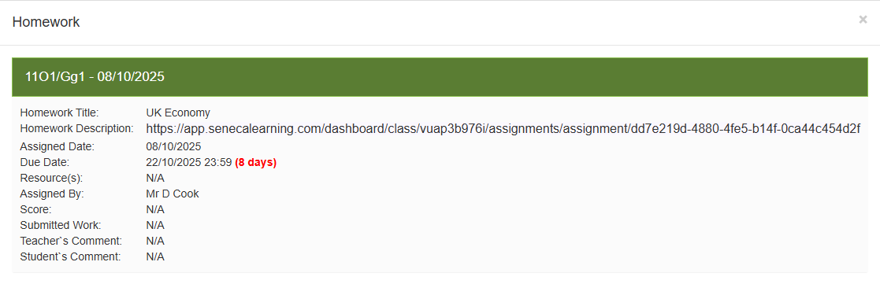

Slide 44
Overview of how can parents/carers support at home
1️⃣ Create the right environment
2️⃣ Help them plan, not panic
3️⃣ Focus on what works in revision
4️⃣ Support, don’t take over
5️⃣ Keep wellbeing front and centre
6️⃣ Stay informed

Slide 45




College teams
Mr Loach-Smith | Mrs Coletta | Mrs Turvey | Miss Odams
Miss McGuiness | Miss Johnson | Mr Walker | Mr Oppong
Mrs Cook | Ms Middleton | Mr Sanford-Casey | Miss Hagan

Slide 46
Year 11 support and Post 16 Options
During Year 11 your child will have;
  Access to a Full Time Careers Adviser
  At least 1 one-to-one Careers Interview
  Support with writing applications and a CV
  The opportunity to attend talks from colleges and apprenticeship providers

Slide 47
Lyng Hall Sixth Form

Slide 48
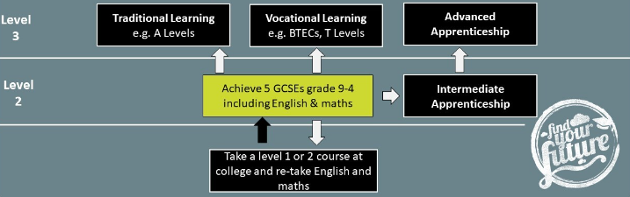
POST-16
After school (Post 16)
The law states that;
“All young people must be in some kind of education or training until the age of 18”
.

Slide 49

Current Subjects
Year 12
Art (Vocational)
Biology (A-level)
Criminology (Vocational)
English (A-level and re-sits)
Enterprise (Vocational)
Health and Social Care (Vocational)
Maths resit
Media (Vocational)
Music Technology (Vocational)
Sociology (A-level)
Sport (Vocational)
Performing Arts (Vocational)
Psychology (A-level))
Year 13
Art (Vocational)
Biology (A-level)
Criminology (Vocational)
English (A-level and re-sits)
Enterprise (Vocational)
IT (Vocational)
Health and Social Care (Vocational)
Law (Vocational)
Maths (A-level and re-sits)
Media (Vocational)
Music Technology (Vocational)
Sociology (A-level)
Sport (Vocational)
Performing Arts (Vocational)
Psychology (A-level)
Uniformed Protective Services (Vocational)
Each subject has 5 hours of tuition per week.
Re-sit Maths and English are also available – 3 hours per week

Slide 50

Consortium
There are a range of different subjects available across Finham Park MAT including 3D Design, Sports Coaching and Chemistry
Currently students consort for Spanish, Physics, Economics, History, Chemistry and Business.
You can consort for 1 subject only
Transport is provided.

Slide 51
Our subjects are not yet fixed...
Education V Level
History
Spanish
Applied Science
Core Maths

Slide 52
How to Apply
P16 prospectus will be published shortly.
Year 11 option polling and discussions to identify offer
Applications will be made through Applicaa this year – more details at the Sixth Form Open Evening.

Slide 53
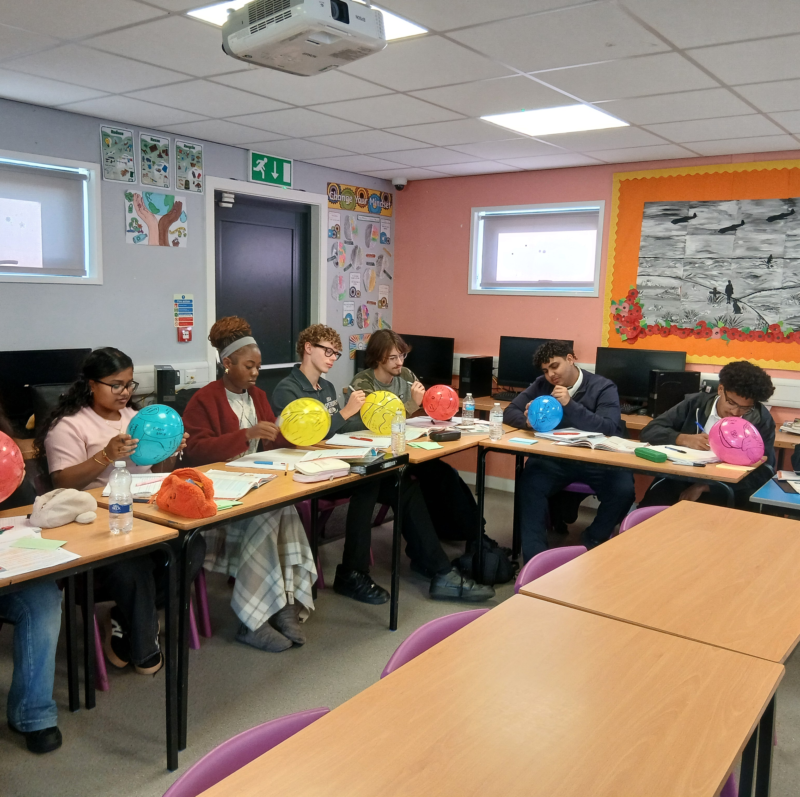
Lyng Hall - a Growing Sixth Form
This year we have 153 students in sixth form.
This is more than double the size we were 4 years ago.

Slide 54

Sixth Form requirements
If you would like to join Lyng Hall Sixth Form next year you will need to meet the following entry requirements:
Vocational subjects such as Music Technology and Criminology require you to achieve five or more grade 4’s.
A-Levels such as Biology, English and Maths require you to achieve five or more grade 5’s.
Sixth Form Open Evening – November 19th

Slide 55
Student quotes
"The best thing about being in Lyng Hall sixth form is the wide opportunities you receive here. There are a wide range of subjects taught here and an active consortium system if the subject is not taught here. The teachers here at Lyng Hall are always supportive and are always willing to help."
Mikolaj Gurzynski, Year 13 (25/26)
“Lyng Hall P16 has helped me by giving me the opportunity to do a fourth subject [Arabic] in addition to my other studies. The teachers here are really talented. The study spaces provided are great and tutor time has really helped me with decisions about my future, like which career and which uni”.
Mohamed Shanab, year 13 (23/24)
“The staff in P16 are really dedicated and I really appreciate it. There’s a lot of will and drive to get things done and get the best for us, that means a lot. I’ve also had amazing opportunities that I don’t think I would get in other schools, like providing all the live sound for a school show as my course-work, that was sick.” Kyle Stilwell, year 13 (23/24)

Slide 56

Outstanding pastoral support
Supporting P16 students is the top priority of the sixth form team.
Dedicated Phoenix College team – Mr Baldwin, Miss Gaggini and Mrs Glancy - direct line of communication if needed.
Support is ALWAYS made available to those that need it and we know our students extremely well.

Slide 57
30 school weeks until GCSEs 2027

Slide 58
Thank you for your time

Slide 59
PEGASUS
DRAGON
GRIFFIN
CENTAUR
Adkins | Liam
Ahluwalia | Ruby
Al Nasouh | Abdul
Alhasan | Mohamad-Nour
Ali | Adam
Ali | Ameen
Ali | Zain
Allsopp | Laynee
Ansar | Muhammed
Arora | Yug
Bah | Samsam
Chorazewicz | Daisy
De Oliveira Ribeiro | Daniel
Dhillon | Balroop
Farrell | Ellie-Mae
Hewitt | Harry
Hislop | Jayden
Horvatova | Karolina
Horvatova | Nataly
Hughes | Olivia
Jackson | Kia
Jagielski | Jakub
John | Mason
Jones | Callum
Judge-Peebles | Rylan
Kasko | Dmitrijs
Lacko | Samuel
Lackova | Anna
Lai | Winston
Langley | Kacey
McGuinness | David
Miah | Liyana
Moore | Christopher
Morgan | Kane
Mushirivindi | Harriet
Nahar | Steven
Nembo Wakam | Lona
Ojeaha | Buchi
Ollerenshaw | Leonard
Oppong | Andrew
Perkins | Amber
Potkaj | Tymon
Rahman | Mahir
Rand | Malakai
Rhodes-O'Connor | Ryan
Shanks | Isabelle
Sharma | Adhya
Simidreanu | Daria
Sivakumar | Kavishka
Smalley | Alfie
Thapar | Aj
Valentine | Caitlin
Varga | Alex
Vijayakumar | Hanusha
Wilcox | Alfie
Williams | Poppy
Wilson | Serena
Worwood | Caitlin
Worwood | Harley-David
Akhtar | Aminah
Badea | Elena- Miruna
Bieda | Alicja
Brennan | Brooklyn
Bustean | Tabita
Connolly | Shay
Galizia | Sienna-Neveah
Gomes | Rodrigo
Hammonds | Christopher
Hussain | Abdullah
Hussain | Dyam
Iqbal | Maira
Jones | Luke
Kaldonek | Wiktor
Kanda | Reuben
Khan | Sirraj
Kocur | Patrycja
Kumari | Aditi
Mally | Angel
Malsbury | Jacob
Mattu | Aayan
Miah | Shayaan
Mihai | Andrada
Mohammed | Rasan
Moir | Kaitlyn
Nuur | Zeena
Olney | Laila
Oyediran | Felix
Pazderski | Dean
Radomski | Adrian
Raybould | Charlie
Singh | Vikash
Staton | Adam
Taylor | Dion
Vaghela | Skyla
Yu | Kevin
Aldridge | Kaison
Borkowska | Zuzanna
Cetinel | Ece
Cetinel | Efe
Conniff | Keira
Cotter | Alex
Crisan | Maria
Dawson | Summer
Drew | Alex
Dudova | Alexandra
Dziedzic | Grazyna
Gabriel | Theophilos
Hangool | Rontic
Hill | Isaac
Hussain | Nafisa
Kaur | Ravinder
Kirton | Casey
Lewis | Jasmine
Marsh | Tiarna
McTigue | Paisley
Meikle | Finlay
Merrett | Lacie-Jane
Nestorenko | Jacob
Orui | Darren
Pawlowicz | Jakub
Pelser | Alexiss
Prime | William
Reed | Kenzie
Skura | Michael
Snaddon | Dylan
Tawiah | Edmund
Terrence | Harry
Thapar | Jaelen
Thompson | Elisha
Thompson | Lacey
Zyra | Zuzanna
Arosh | Aiyan Jaman
Arvai | Alexandra
Evans | Kyle David
Gabor | Jaromir
Grochowski-Salwiczek | Diego
Gyan Obeng | Michael Christian
Hagan | Amy
Hagan | Emily
Halford | Evie
Hall | Ruby
Higgins | Logan
Hodgson | James
James | Logan
Jones | Eden
Kabango | Samrah
King | Aaron
Kitching | Joshua
Lever | Ellis
Loqman | Sema
Mengesha | Kidus
Mihu | Mateo
Mogaji | Mukaila
Morey | Emily
Osarenren | Prudence
Patel | Devansh
Pritchard | Lilli-Maii
Ramsay | Jaydon
Secnovs | Nikita
Serge | Ashanti
Subhani | Muhammad
Thayne | Riley
Vesper | Aaron
Ward | Keian
Wright | Harvey

