Slide 1
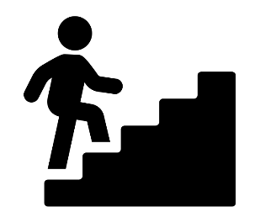


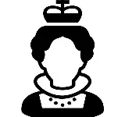


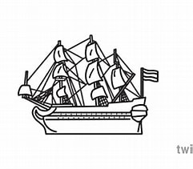


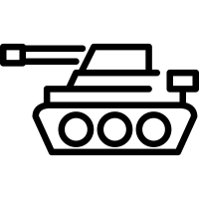



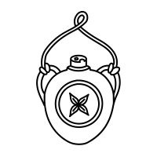
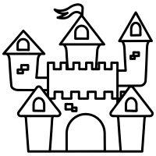
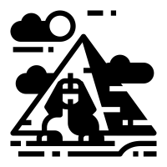
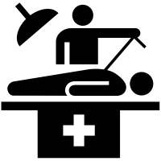



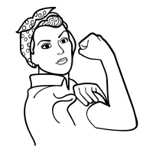
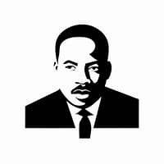
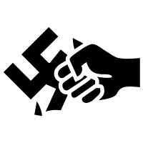



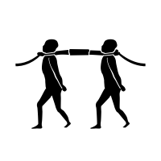
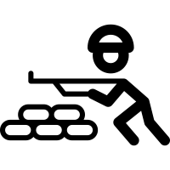


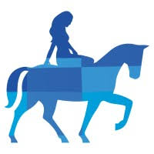










History Learning Journey - Knowledge
Where are areas of surplus and deficit located globally?
Revision – based on identified gaps
How did England explore and expand?
How did life change under Elizabeth I?
Revision – all units.
YEAR
Elizabethan England
Elizabethan England
11
Elizabethan place study
How did Elizabeth win the war with Spain?
How did Hitler gain power?
How did Nazi rule affect German people?
Democracy and Dictatorship
How did WW1 End??
How did the ToV contribute to WW2?
How did WW1 impact on Germany?
Conflict and Tension
Conflict and Tension
Democracy and Dictatorship
How has public health changed in modern Britain?
What happened at the end of WW!?
How did WW2 start?
What was the Weimar republic?
Health and the People?
How did the industrial revolution affect health?
How did people in medieval times treat illness
How did ancient people treat illness?
YEAR
Health and the People
10
Ancient Medicine
How did medicine change during the Renaissance?
What can we learn from ancient medicine?
What was the Holocaust?
The Holocaust
How did life change in the post war period?
What was the Civil Rights movement?
Modern History
Modern History
Modern History
What was the impact of the Treaty of Versailles?
How did the Great Depression start?
What were the impacts of the Great Depression?
How did WWW1 and WW2 begin and end?
How did people in Britain get the right to vote?
What was the Industrial revolution?
How did slavery begin and end?
YEAR
9
Suffrage
The Industrial revolution
Slavery and Empire
How did women get the right to vote?
Why was Britain the first country to industrialise?
What was the slave triangle?
Who were the Stuarts?
The Stuarts
Why is the gunpowder plot important?
What are the key historical events for Coventry?
Why was Britain at War for 100 years+?
How did life change in Tudor times?
YEAR
Local History Project
8
England at War
The Tudors
What was the impact of the Black Death?
Why did the peasants revolt and how did that change Britain?
How has History shaped Coventry?
How did the conflict with France affect Britain?
How did the Reformation affect Britain?
The Black Death and the peasants revolt
What was life like in Medieval Times?
Why and how were castles used?
How did William gain control of Britain?
How did the Romans change Britain?
YEAR
Medieval Life
Norman Castles
The Norman Conquest
Britain Pre-1066
7
How was Britain ruled during Medieval times?
How did castles change over time?
How did the Normans change Britain?
What are the key skills we need in History?
"We are not makers of history. We are made by history.“ M Luther King

