Slide 1
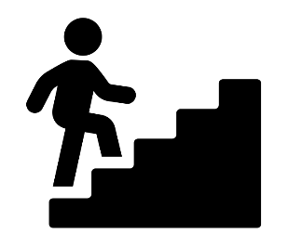




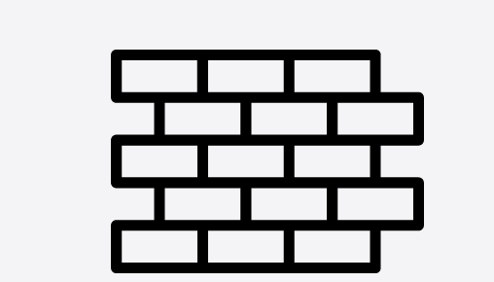





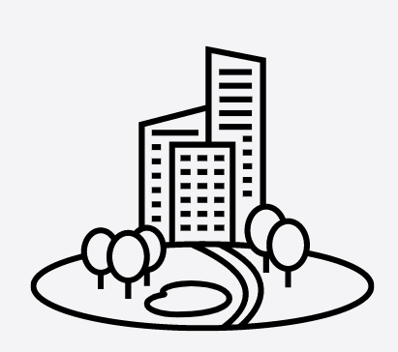
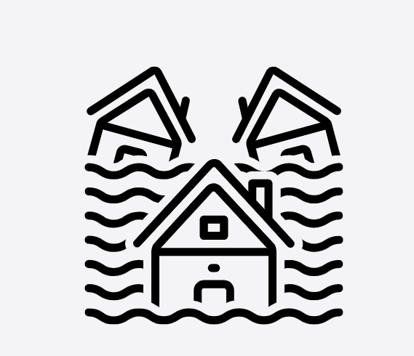












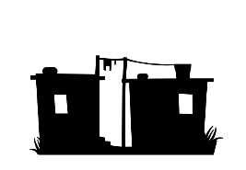




















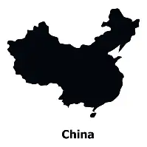










How can we answer the exam questions?
REVISION & PRE-RELEASE
Geography Learning Journey - Knowledge
REVISION
What have we learnt?
How can we manage food as a resource?
How has Birmingham Changed over time?
YEAR
REVISION
HOW CAN WE MANAGE FOOD GLOBALLY?
FIELDWORK: Birmingham investigation
11
FIELDWORK: river study
Why is food a scarce resource?
Has the regeneration of Birmingham been successful?
Fieldwork
Can deserts be developed?
Why are more people living in cities?
How can we reduce the risk of flooding on people and the environment?
SHOULD DEVELOPMENT COST US THE ENVIRONMENT?
HOW ARE GLOBAL CITIES CHANGING?
HOW CAN WATER SHAPE THE LAND??
How do natural hazards happen?
Why is development a threat to tropical rainforests?
How has urbanisation affected Lagos?
How have rivers shaped the landscape?
HOW DO HAZARDS AFFECT PEOPLE?
Do hazards affect us all equally?
What is unequal development?
How are squatter settlements linked to urbanisation?
COULD WE MAKE THE WORLD MORE EQUAL?
YEAR
10
HOW CAN WE MANAGE SQUATTER SETTLEMENTS?
How can we reduce the development gap?
How can squatter settlements be managed?
What is glaciation?
?
Why does the British landscape look like it does?
How has agriculture changed the landscape?
What does inequality look like?
How can the weather cause hazards?
What are the important resources?
HOW IS THE WORLD UNEQUAL?
HOW DOES THE PLANET CAUSE HAZARDS?
HOW CAN WE SUSTINABLY MANAGE RESOURCES?
What is an ecosystem?
WHY DO ECOSYSTEMS NEED PROTECTING?
How are humans impacting the global ecosystems?
What causes inequality?
How can the earth cause hazards?
How does the UK manage its resources?
What processes shape coasts?
What happens beneath our feet?
Why is the Middle East an important economic region?
YEAR
Why do coasts change shape?
WHY IS THERE CONFLICT IN THE MIDDLE EAST?
9
WHY DO EARTHQUAKES HAPPEN?
WHY IS THERE CONFLICT IN THE MIDDLE EAST?
How do these processes create landforms?
Is everyone affected equally?
Which factors cause the conflict in the Middle East?
Why are more people living in urban areas?
WHY ARE CITIES A CHALLENGE?
What are the challenges for Mumbai?
What is the one child policy
How do people choose where to settle?
How have plants and animals adapted to cold environments?
YEAR
What is China like?
8
WHERE DO PEOPLE LIVE?
How can we manage cold environment?
Why is Africa an important continent?
How did China become a superpower?
How is this impacting on global resources?
Can cold environments be developed?
WHY IS AFRICA IMPORTANT?
What are the opportunities and challenges facing Africa?
Why some countries developing so quickly?
How does a river change downstream?
What are the different countries in the UK?
How can physical geography help us to understand the world?
YEAR
WHY IS DEVELOPMENT UNEVEN?
WHY DO RIVERS CAUSE FLOODS?
WHAT IS THE GEOGRAPHY OF THE UK LIKE?
WHAT IS GEOGRAPHY?
7
Why is there so much poverty in the world?
What causes floods to happen?
What is different for people in different parts of the UK.?
Why is human geography important?
‘ Geography is the subject which holds the key to our future. ’

